Slide 1
Correlation Analysis

Slide 2
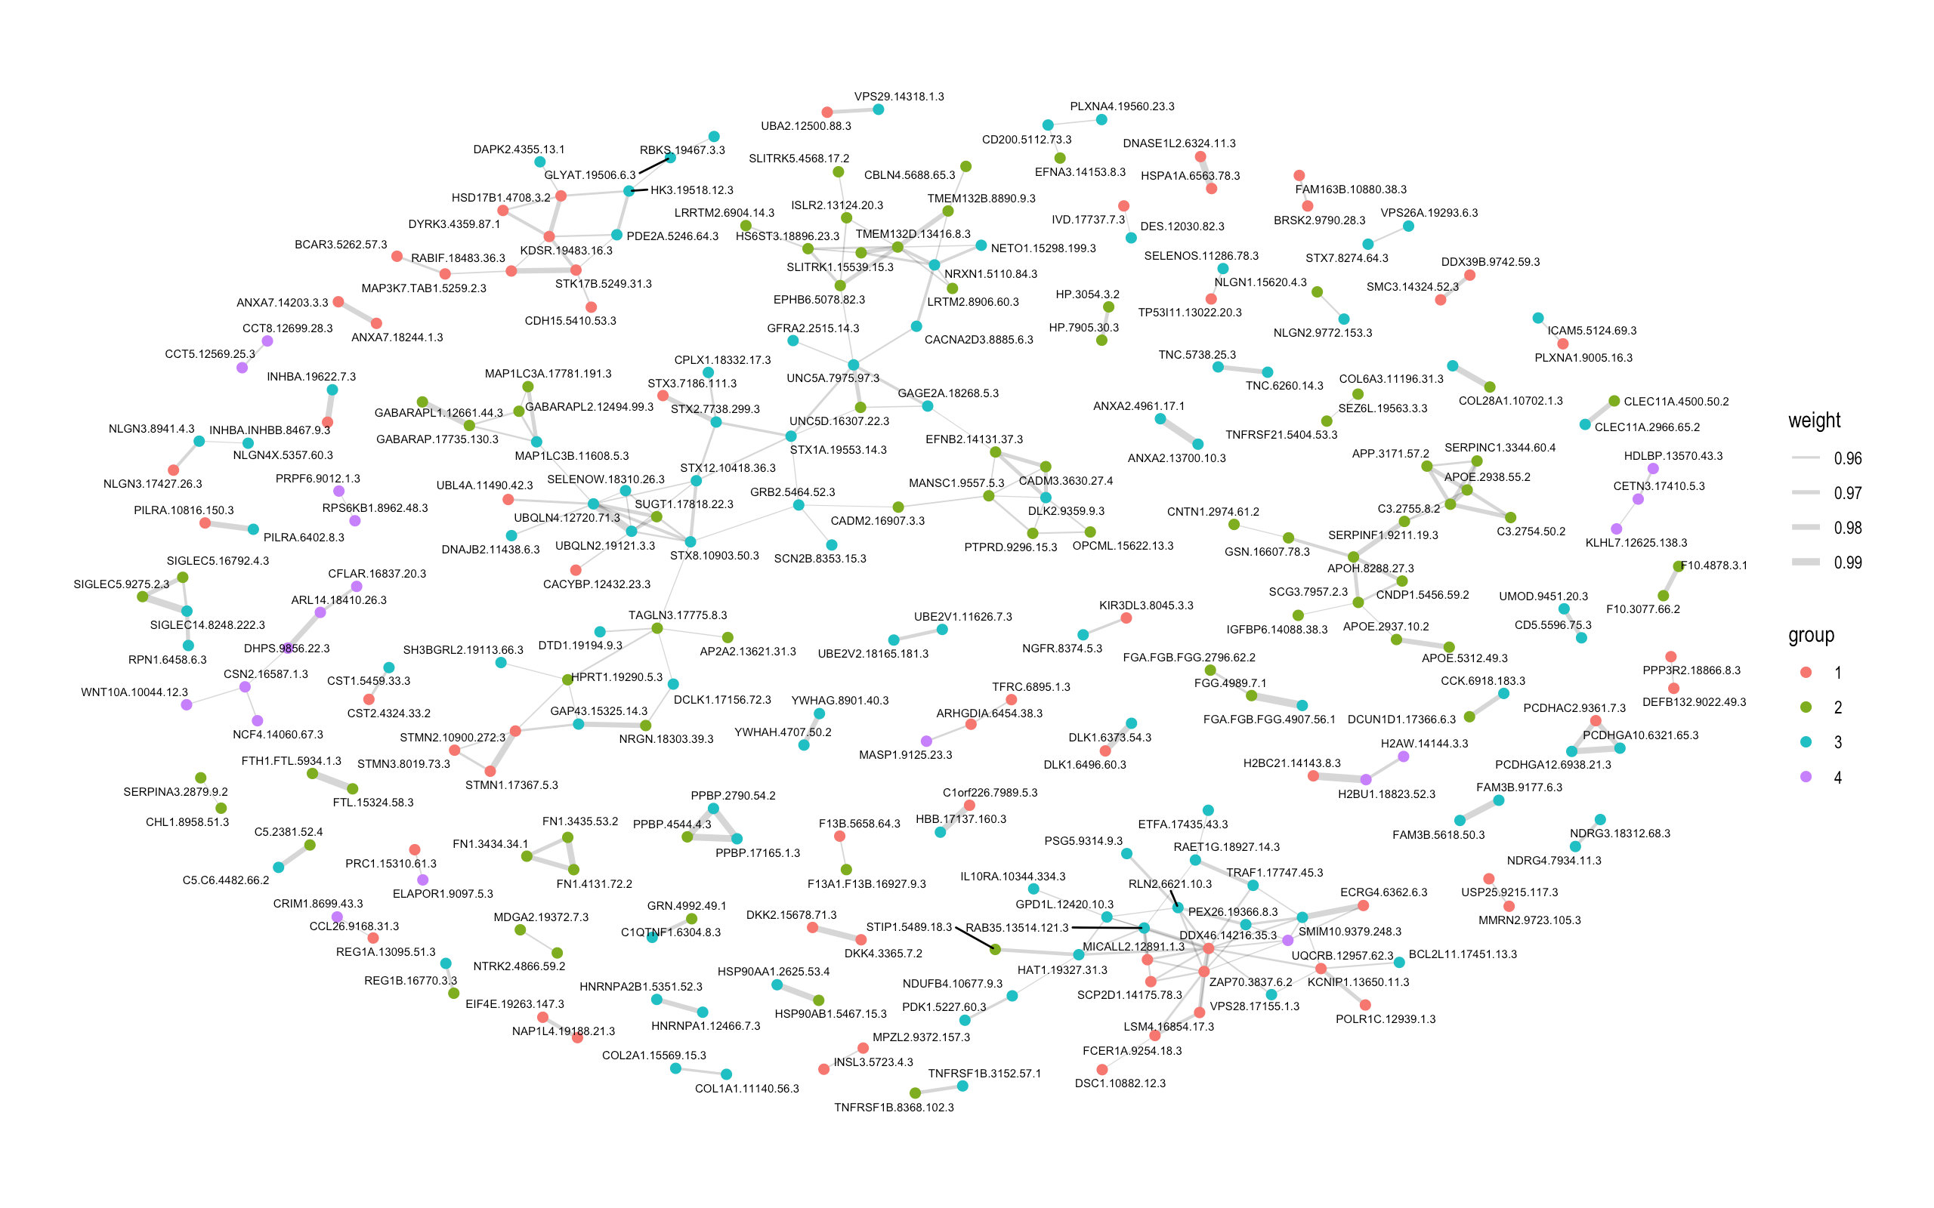
Correlation Network of Stanford CSF Proteomes
(Hierarchically clustered, filtered by significance of correlation)

Slide 3
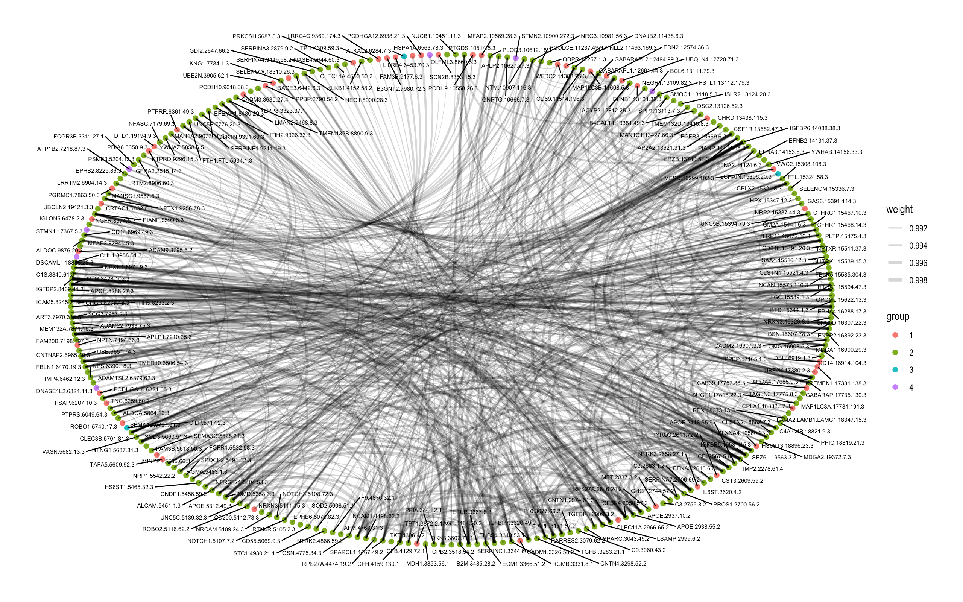
Correlation Network of Stanford CSF Proteomes
(Hierarchically clustered, unfiltered)

Slide 4
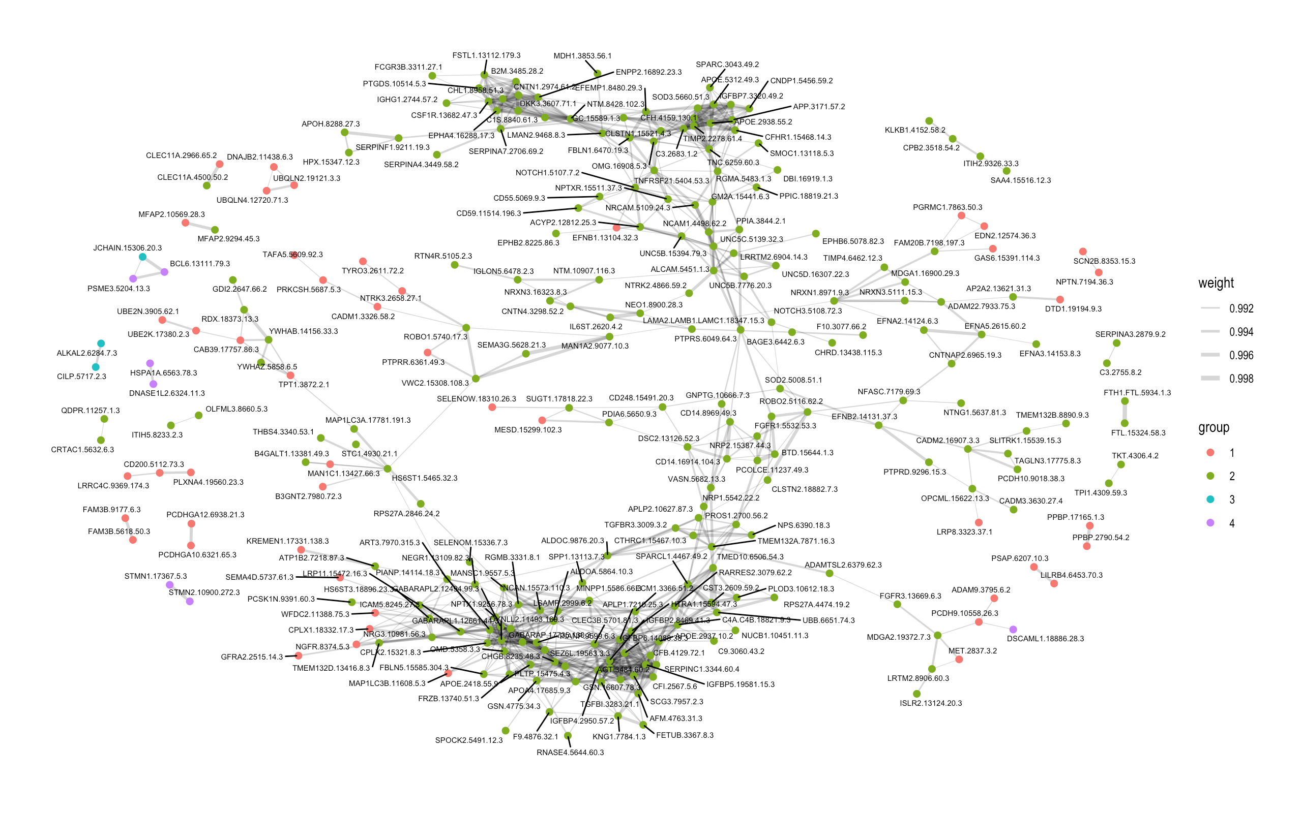
Correlation Network of Stanford CSF Proteomes
(Hierarchically clustered, unfiltered)

Slide 5
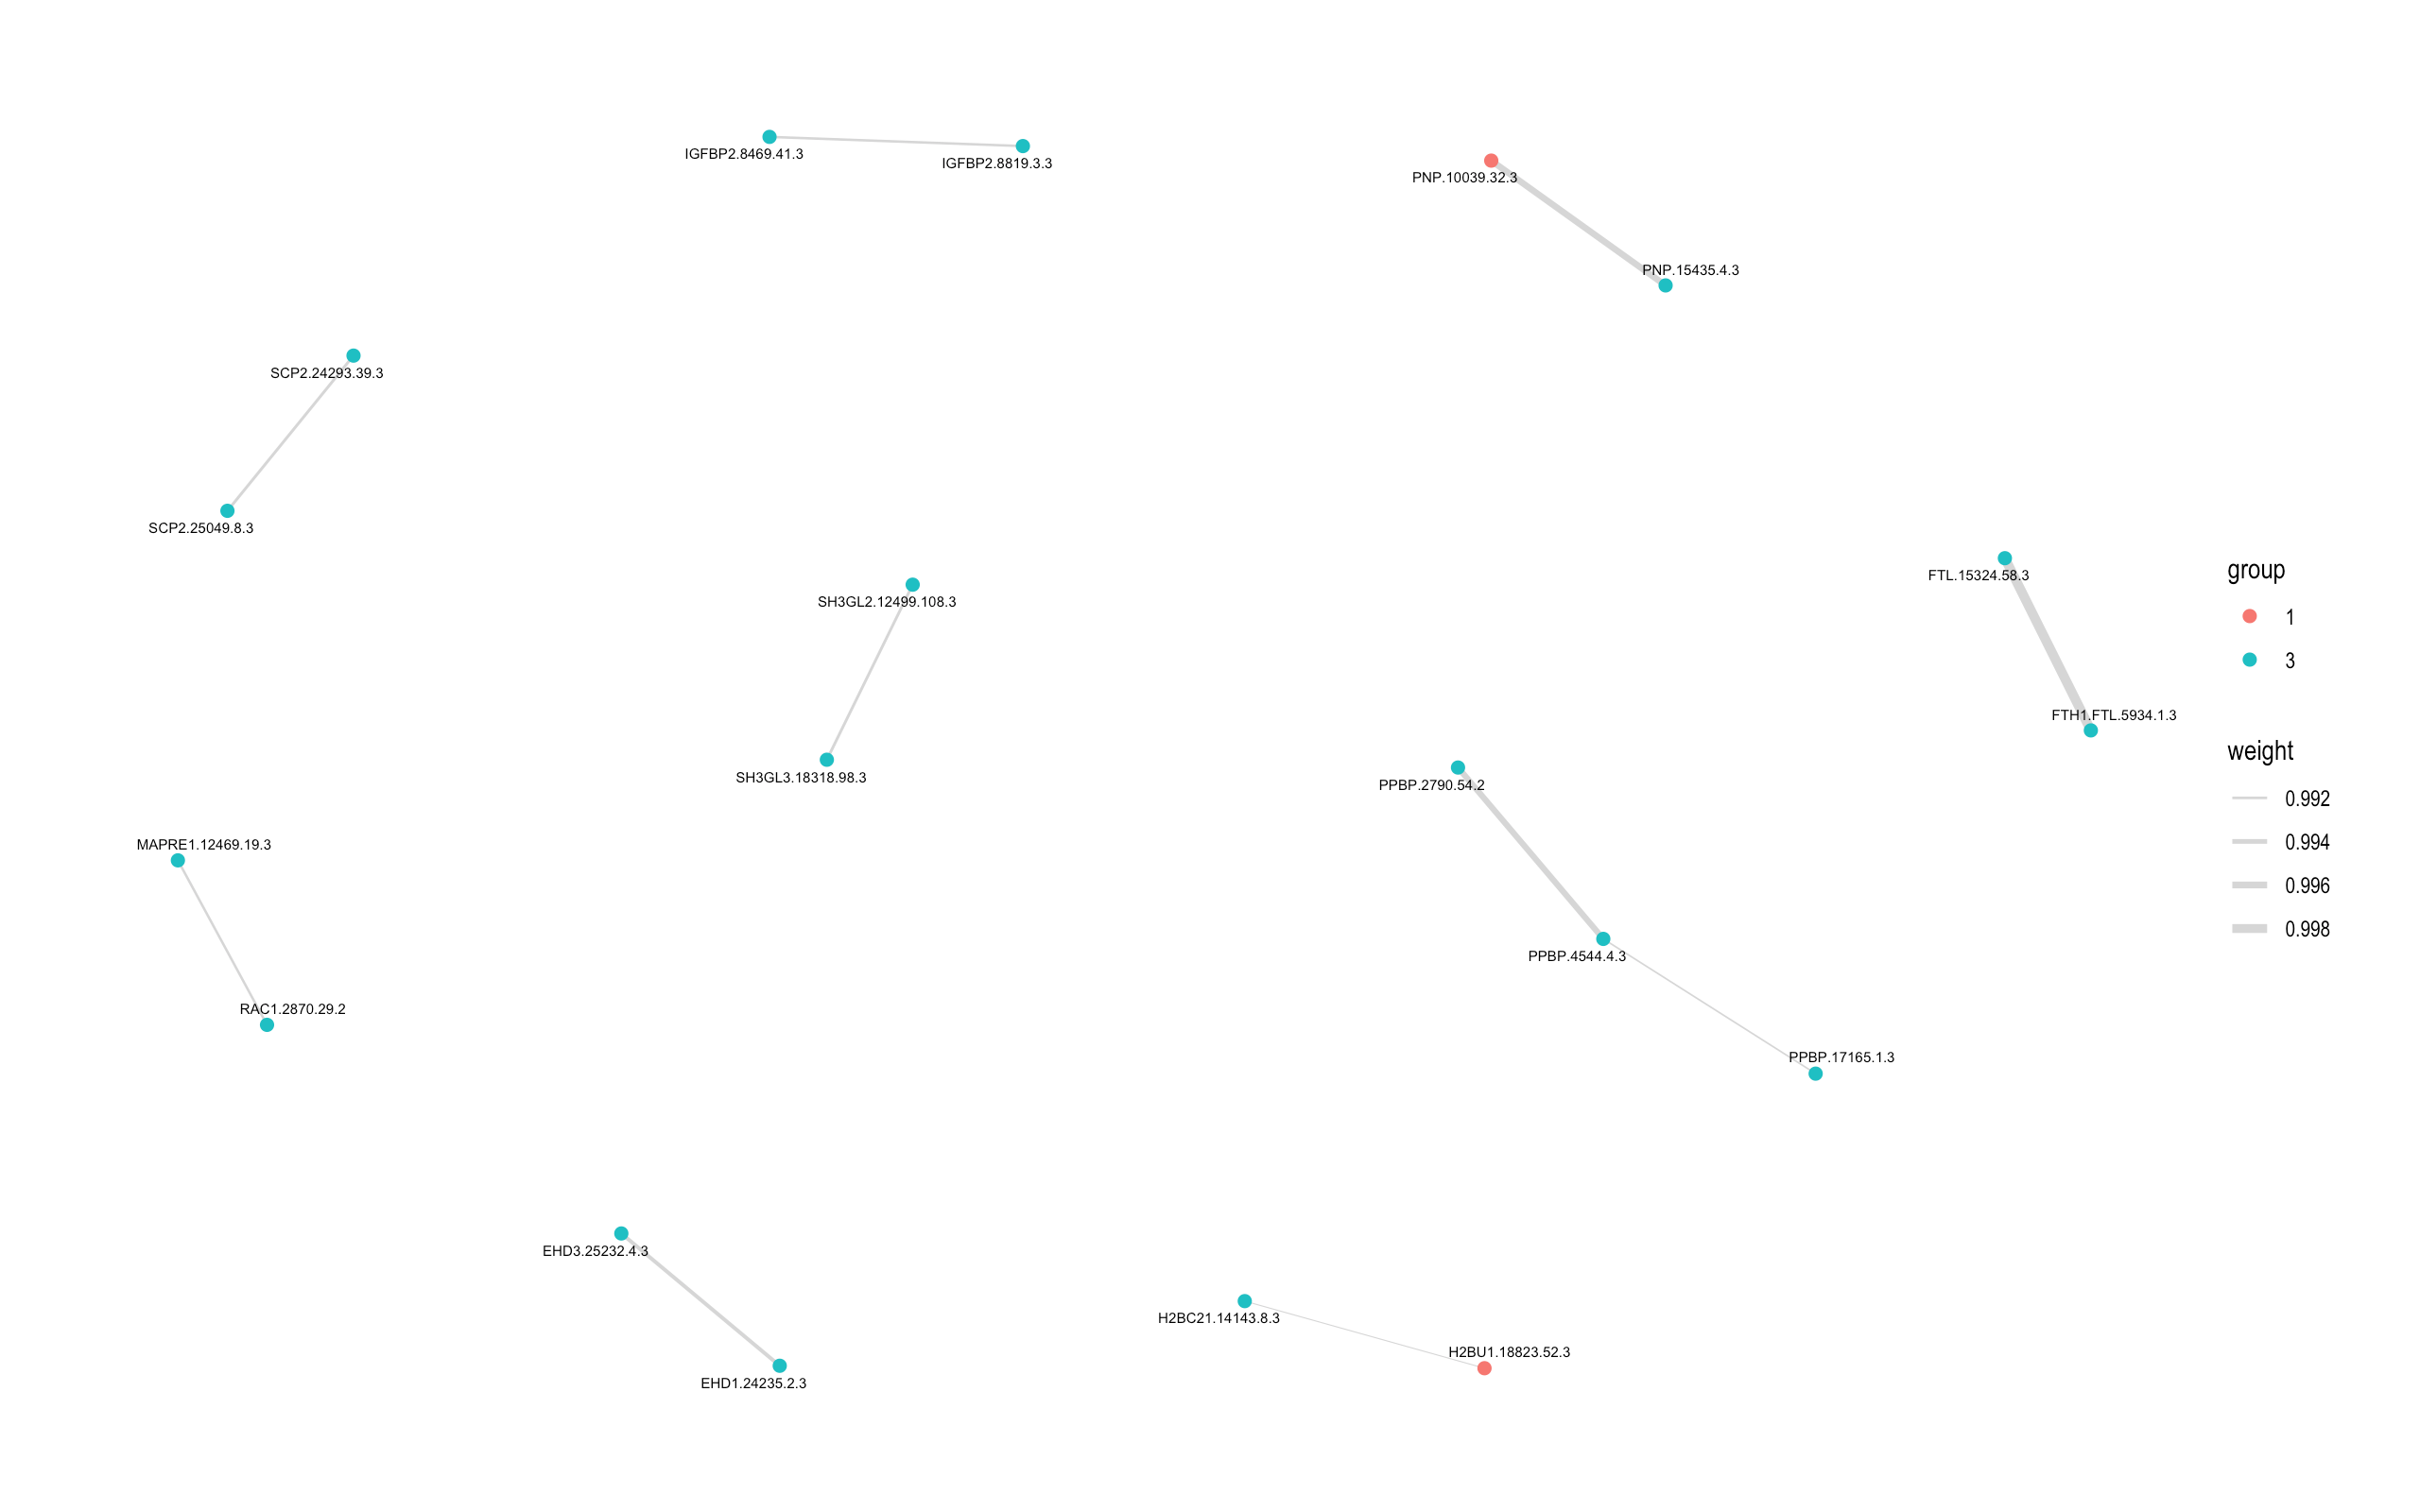
Correlation Network of Stanford Plasma Proteomes
(Hierarchically clustered, filtered by significance of correlation)

Slide 6
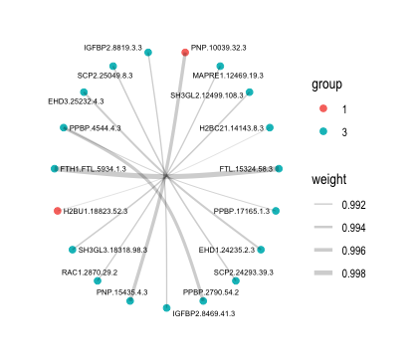
Correlation Network of Stanford Plasma Proteomes
(Hierarchically clustered, filtered by significance of correlation)

Slide 7
Dimensionality Reduction

Slide 8
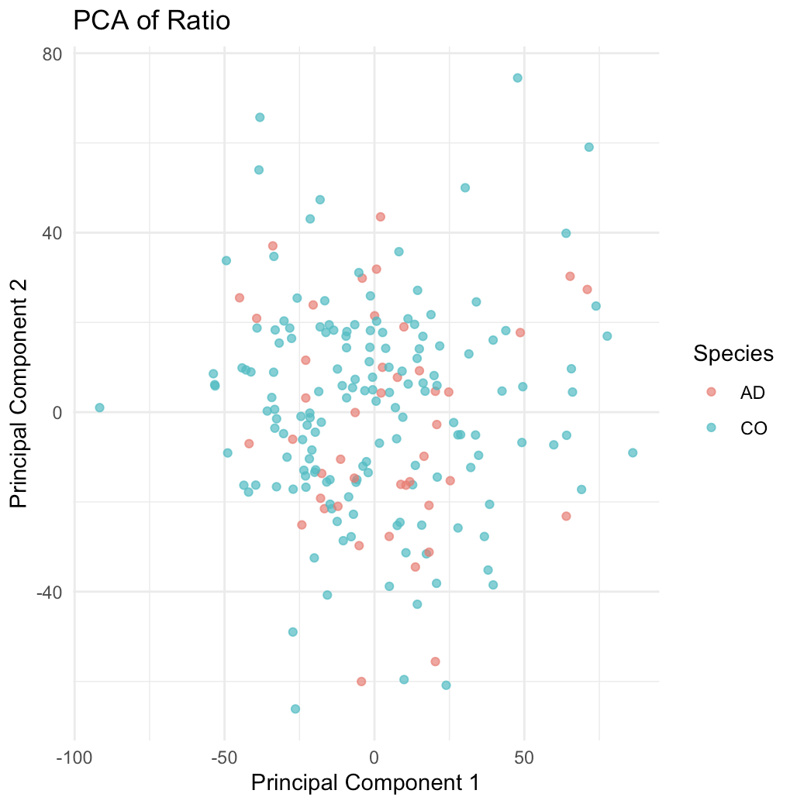
Knight Dataset w/ drawdate difference <= 120 days, PCA of CSF-Plasma Ratio

Slide 9
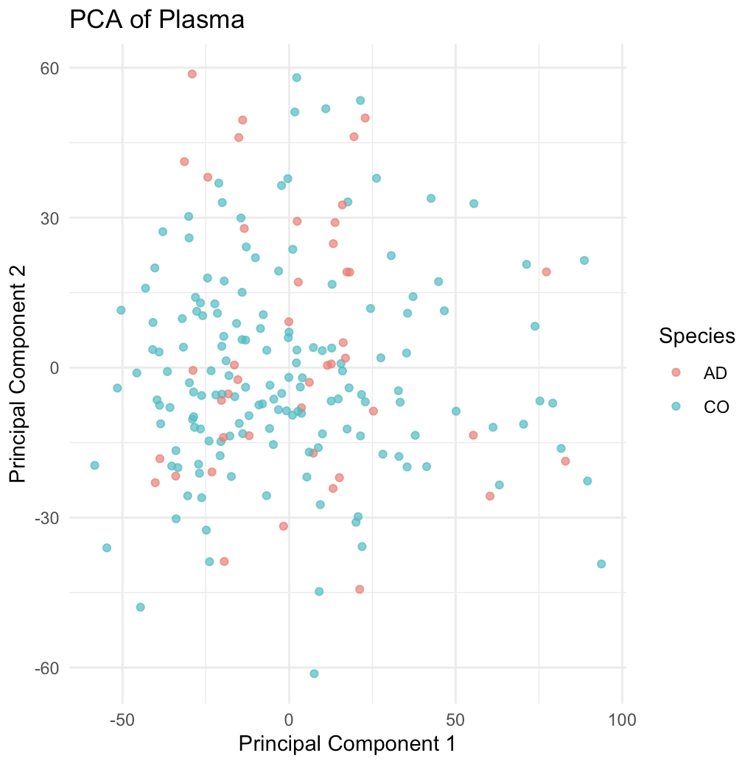
Knight Dataset w/ drawdate difference <= 120 days, PCA of Plasma

Slide 10
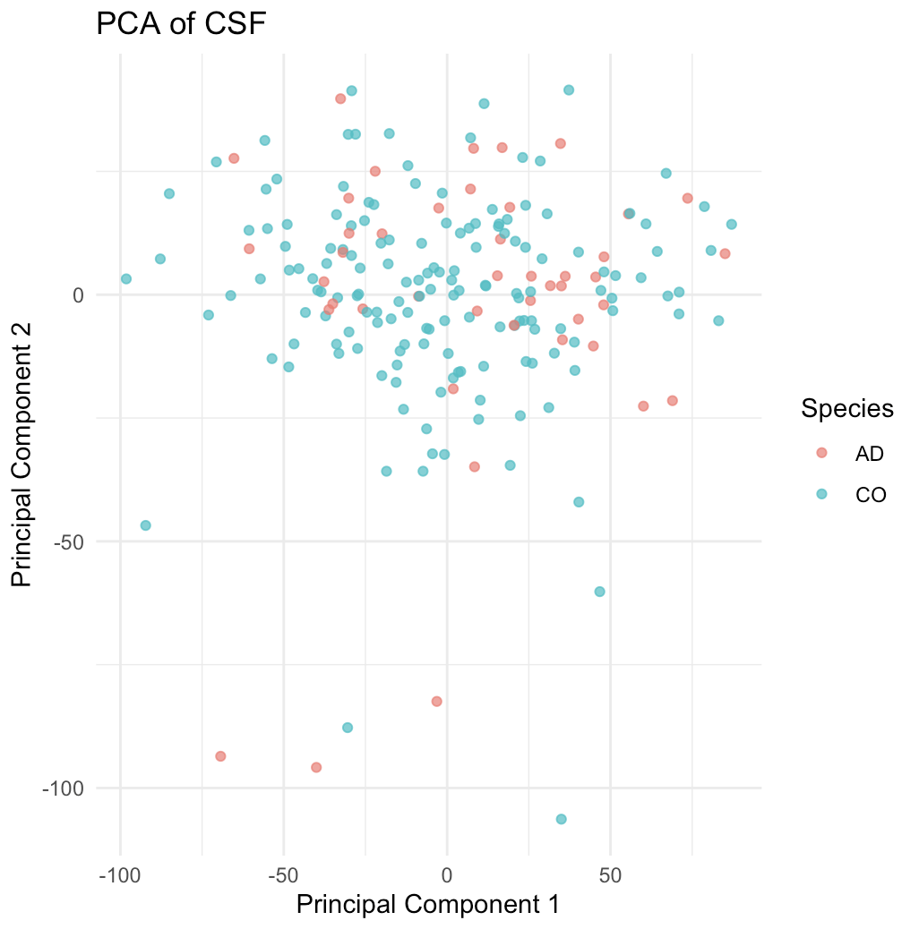
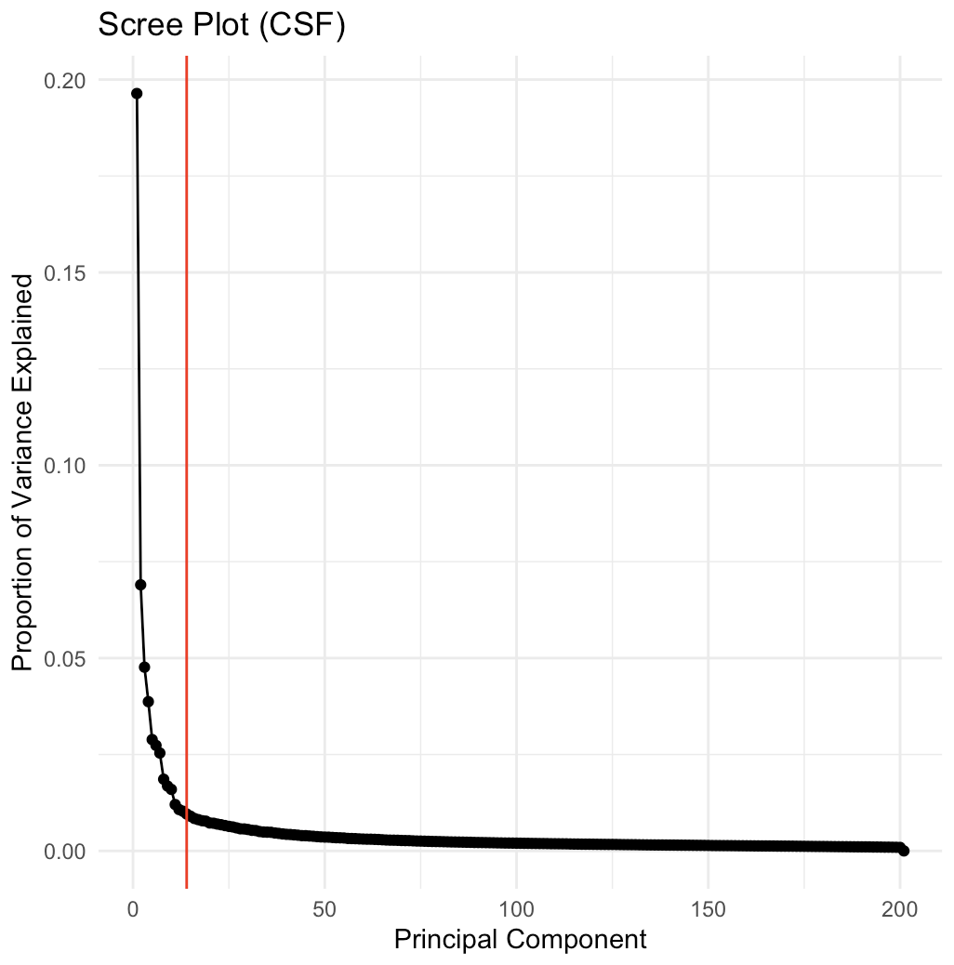
Knight Dataset w/ drawdate difference <= 120 days, PCA of CSF
Same dataset, Scree plot

Slide 11
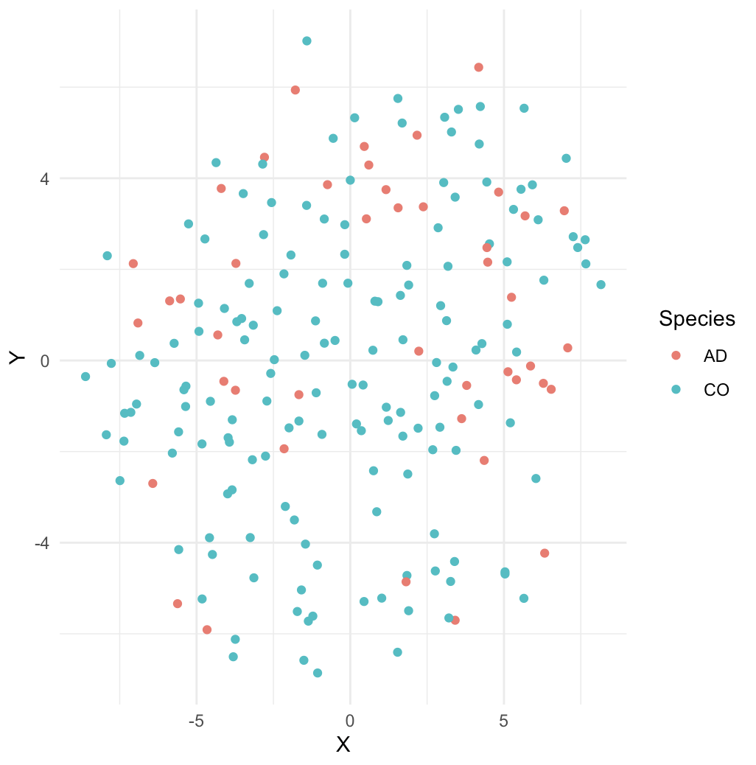
Knight Dataset w/ drawdate difference <= 120 days, T-SNE of CSF

Slide 12
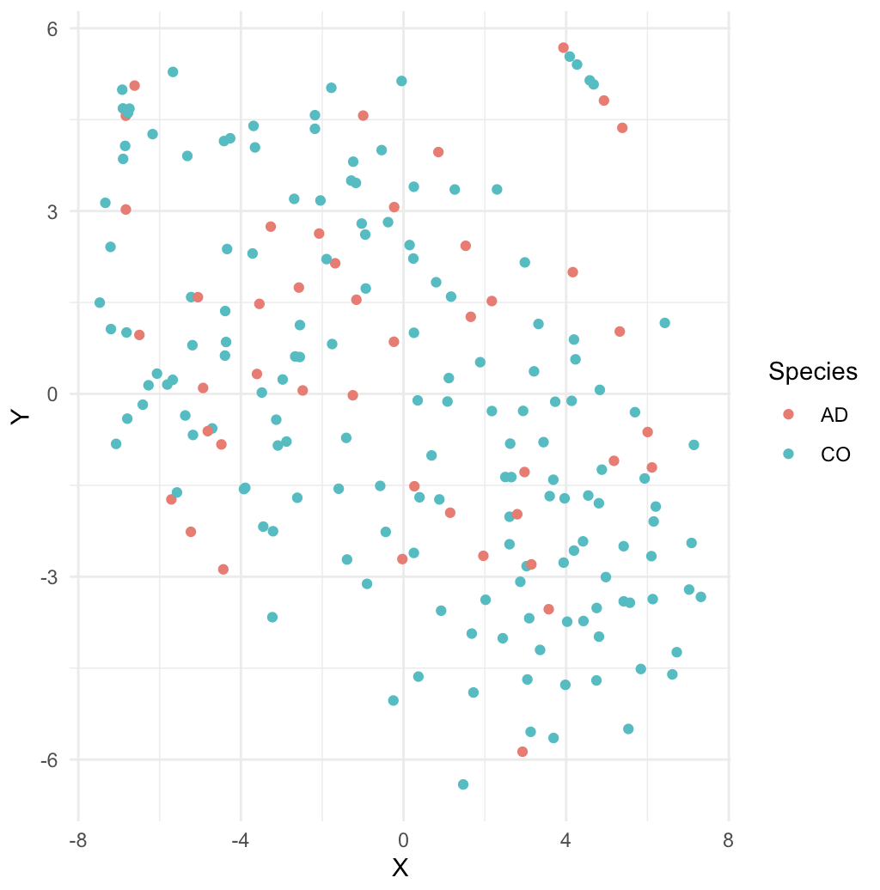
Knight Dataset w/ drawdate difference <= 120 days, T-SNE of CSF – Plasma Ratio

Slide 13
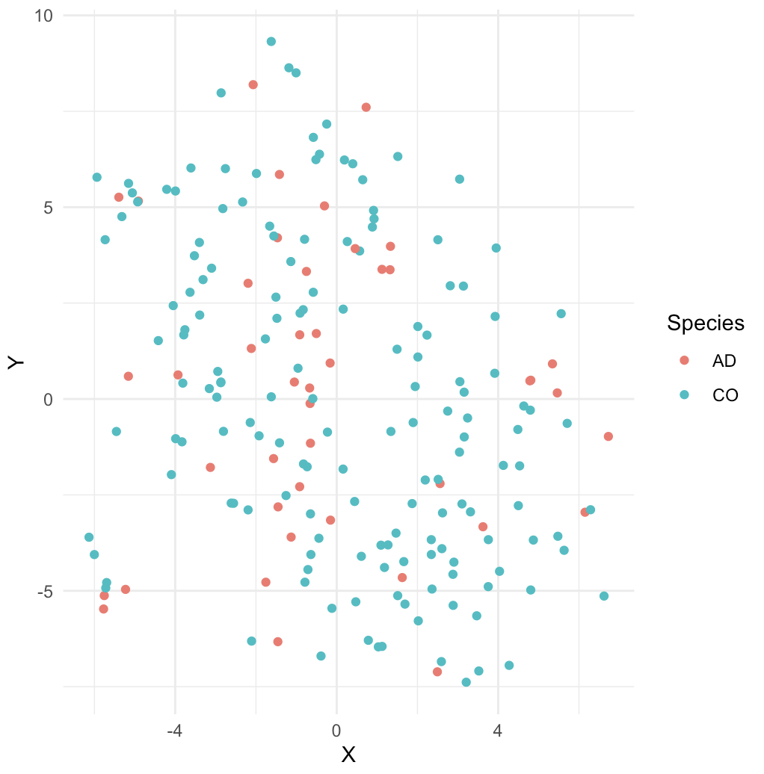
Knight Dataset w/ drawdate difference <= 120 days, T-SNE of Plasma

Slide 14
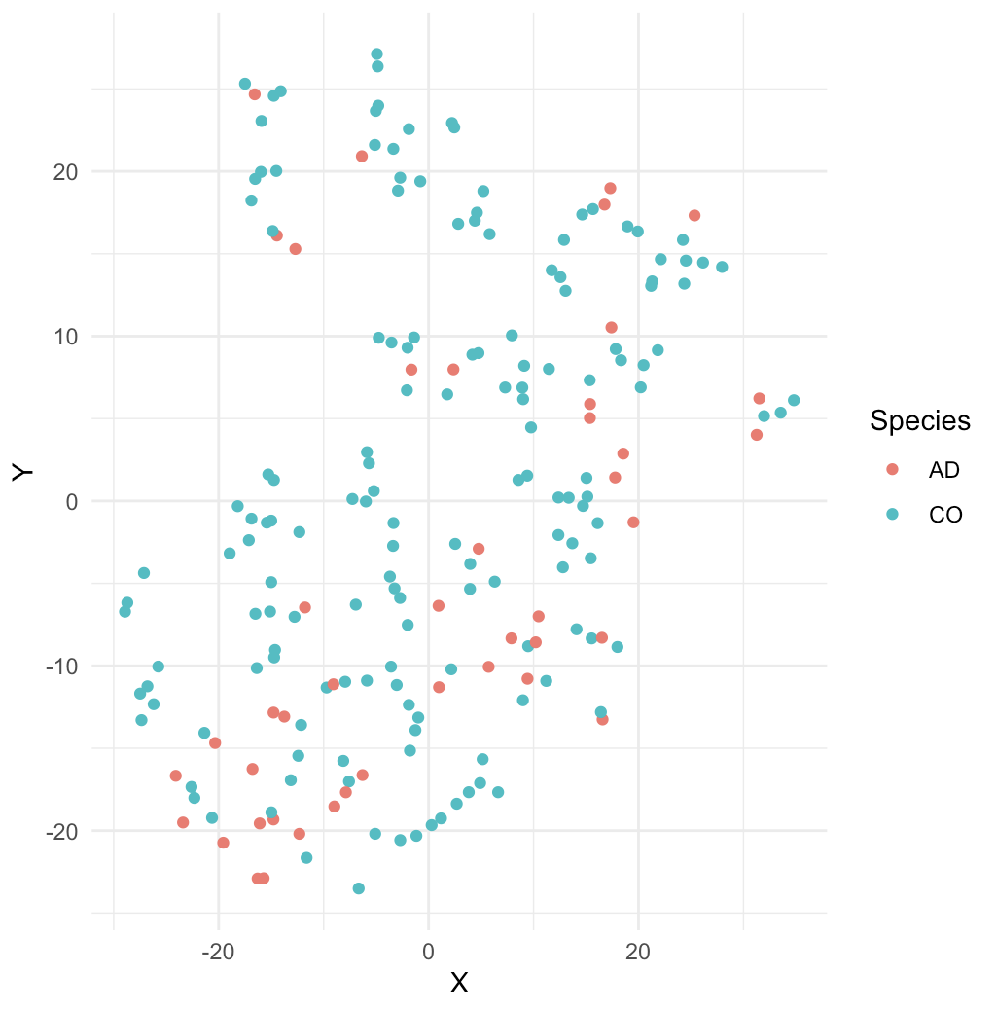
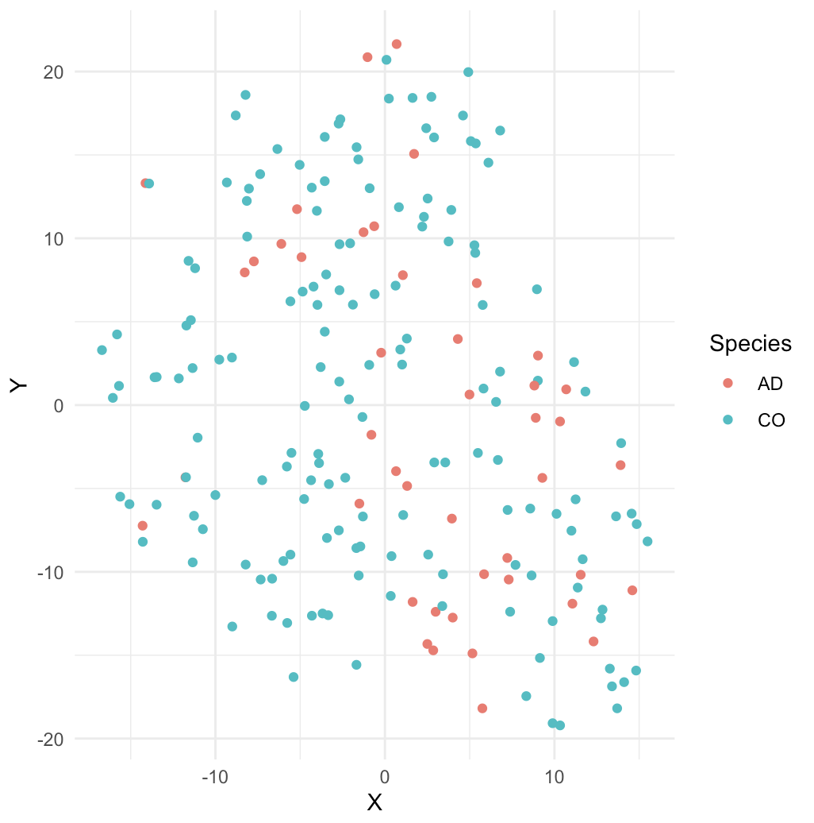
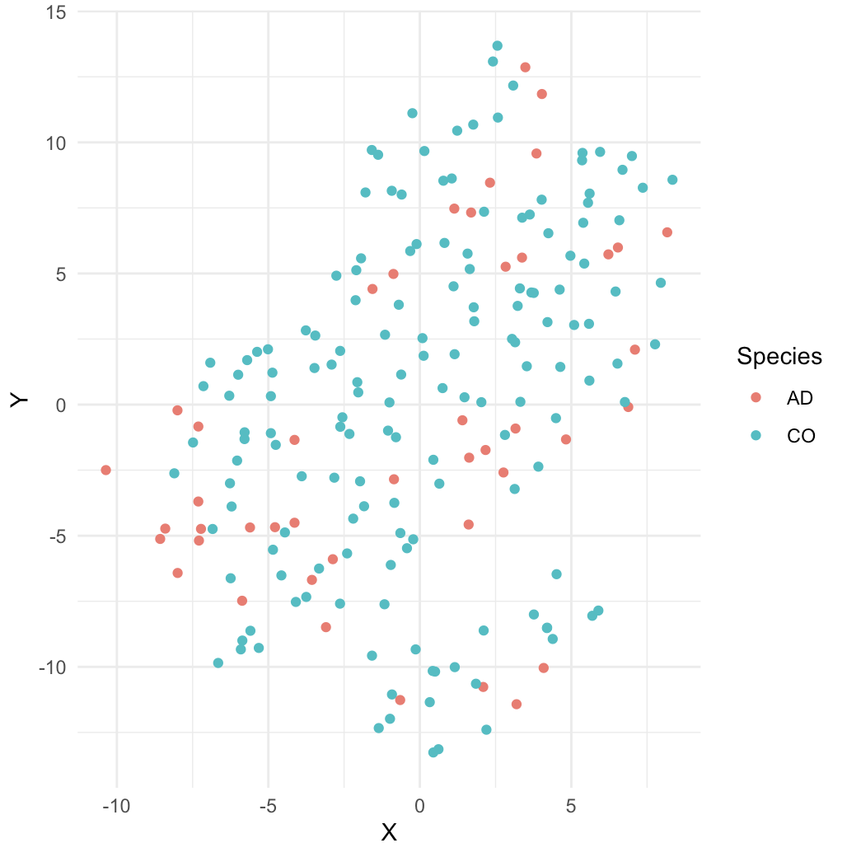
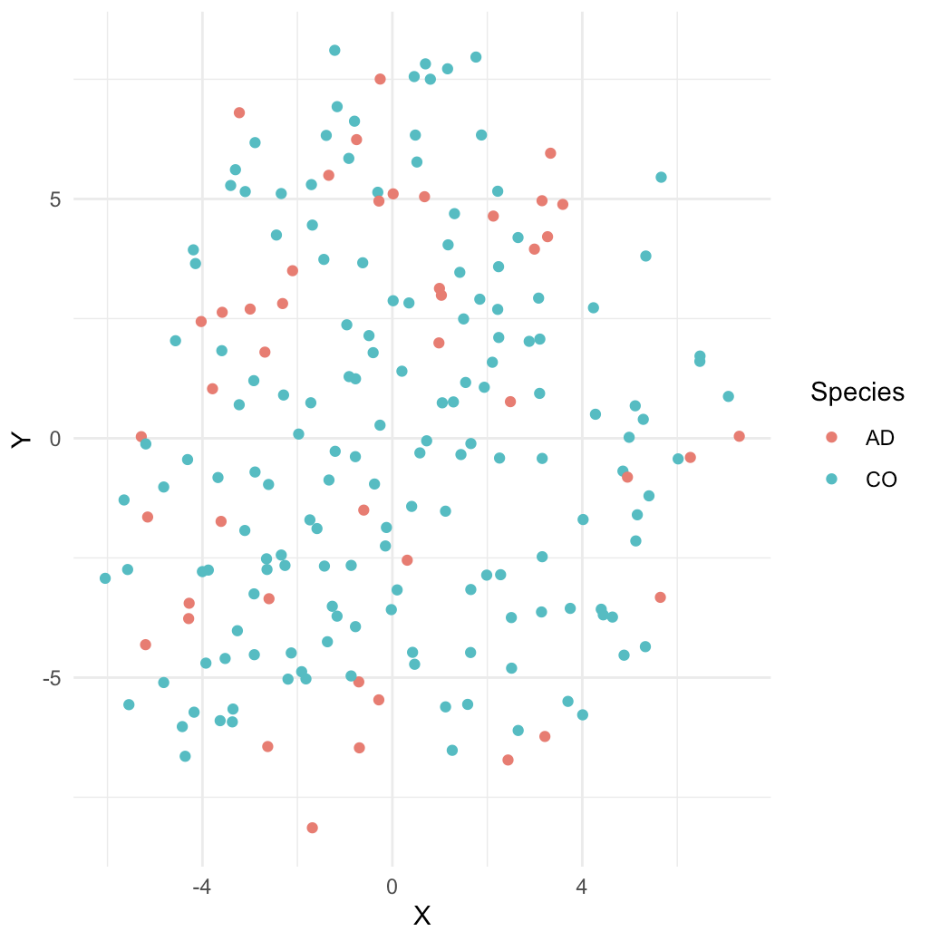
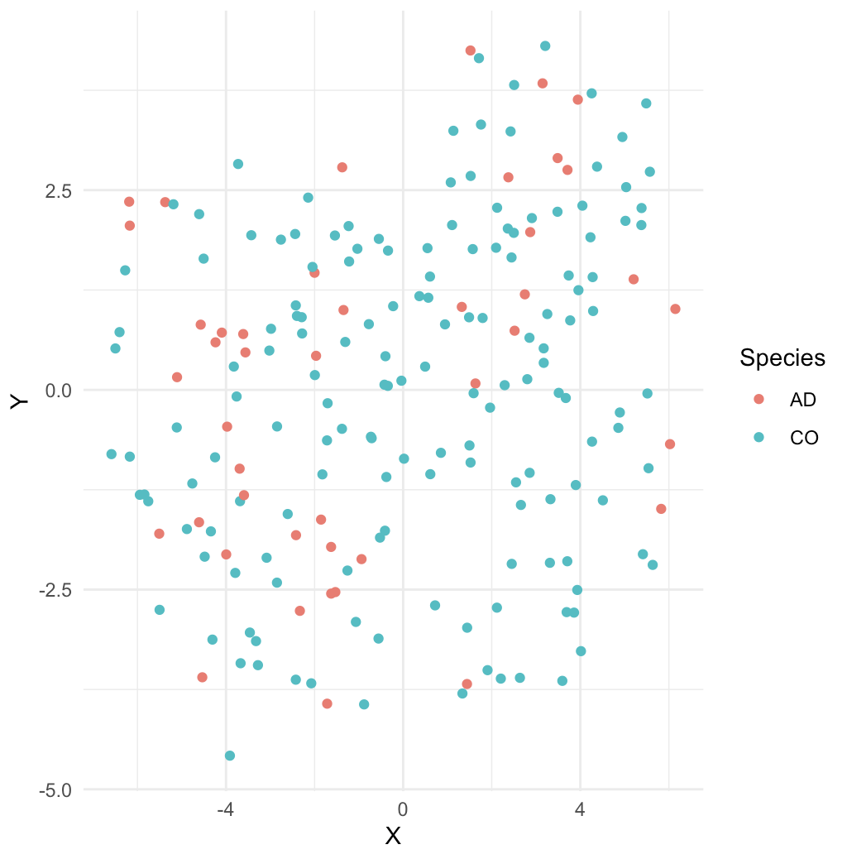
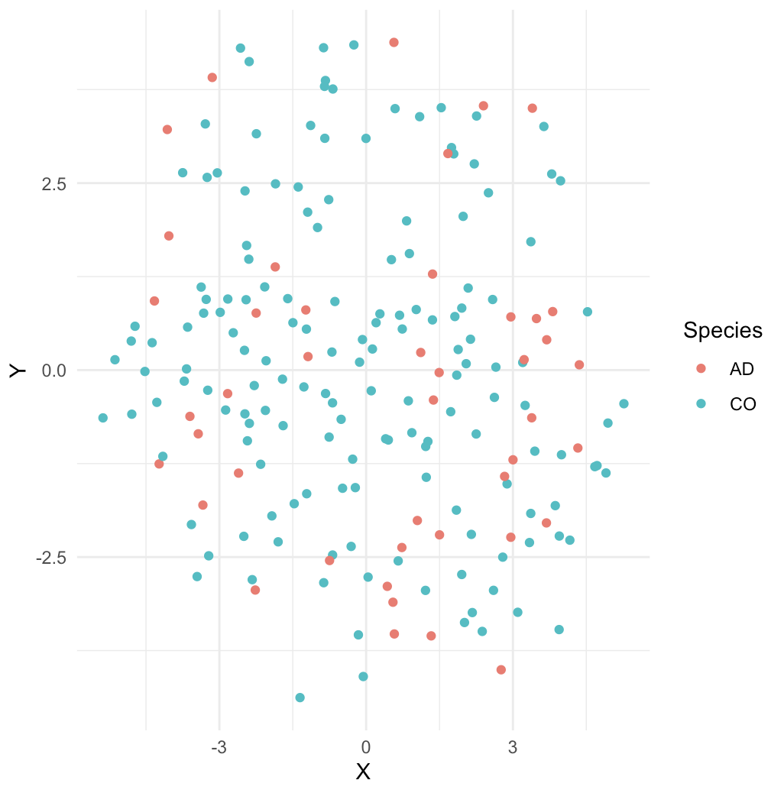
Perplexity =
5, 10, 20,
30, 40, 50
Knight Dataset w/ drawdate diff <= 120 days, T-SNE of CSF w/ different perplexities

Slide 15
Linear Regression to
Predict Biological Age

Slide 16
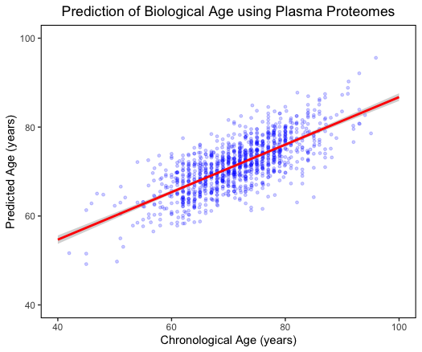
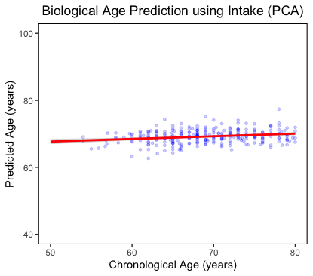
Ran on Stanford Dataset.
Uses linear regression to predict chronological age from plasma proteomes (left)
Uses linear regression to predict chronological age from plasma-CSF ratio, but two principal components (right)

Slide 17
Exploratory Data Analysis –
Sample Population Histograms

Slide 18
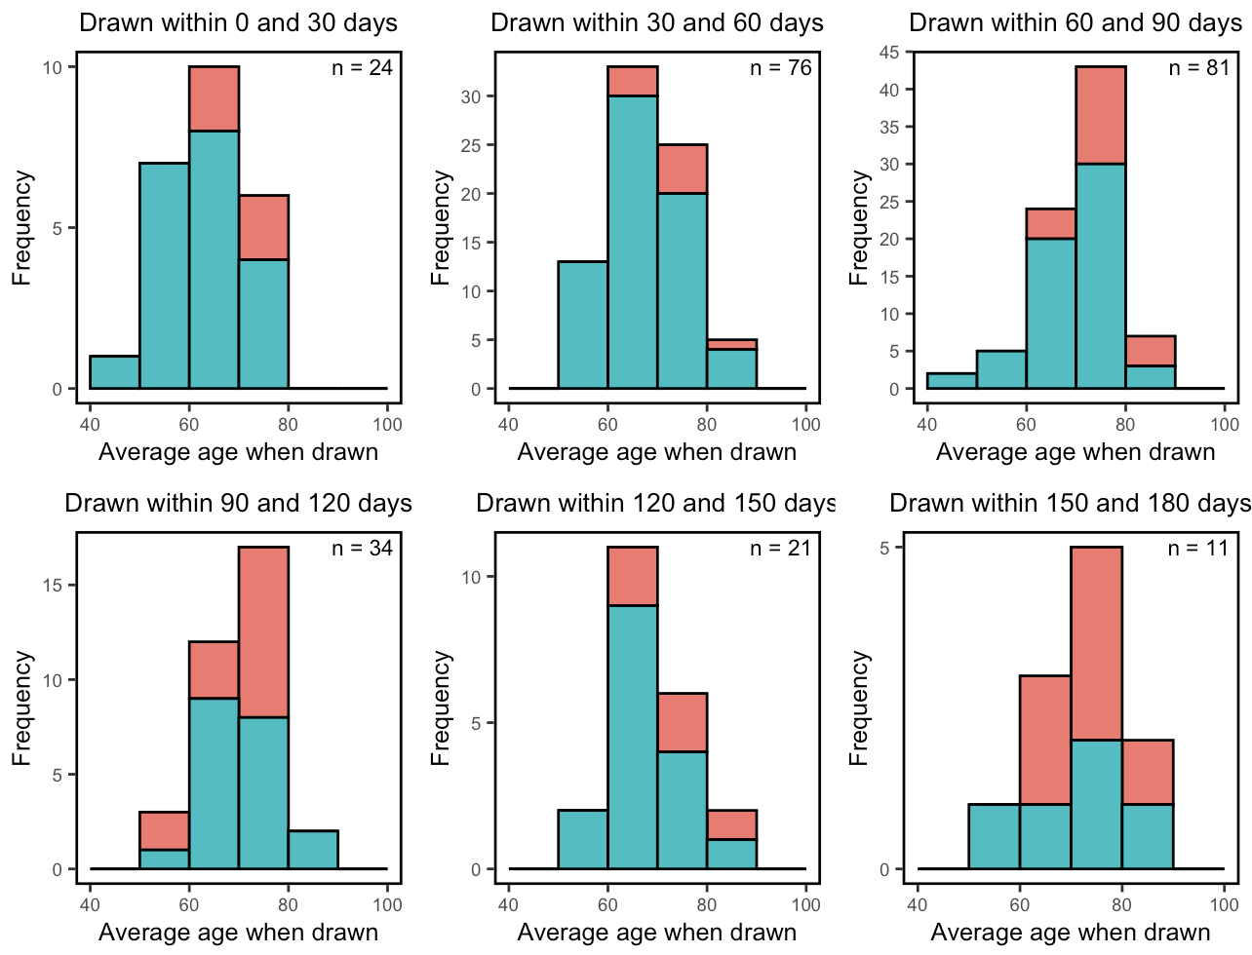
Population for patients from Knight Dataset < 180 days
* This is before summer, when we filtered out the ambiguous patients in the Knight dataset.

Slide 19
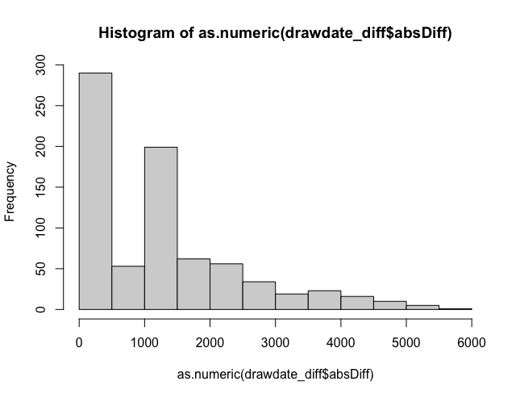
Population for patients from Knight Dataset

Slide 20
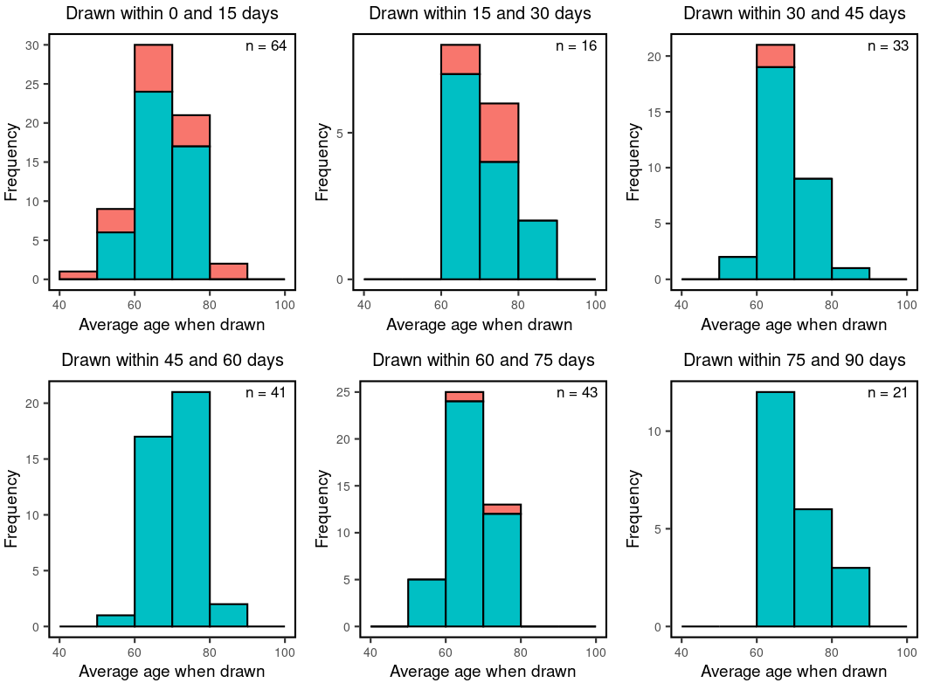
Population for patients from Stanford Dataset

Slide 21
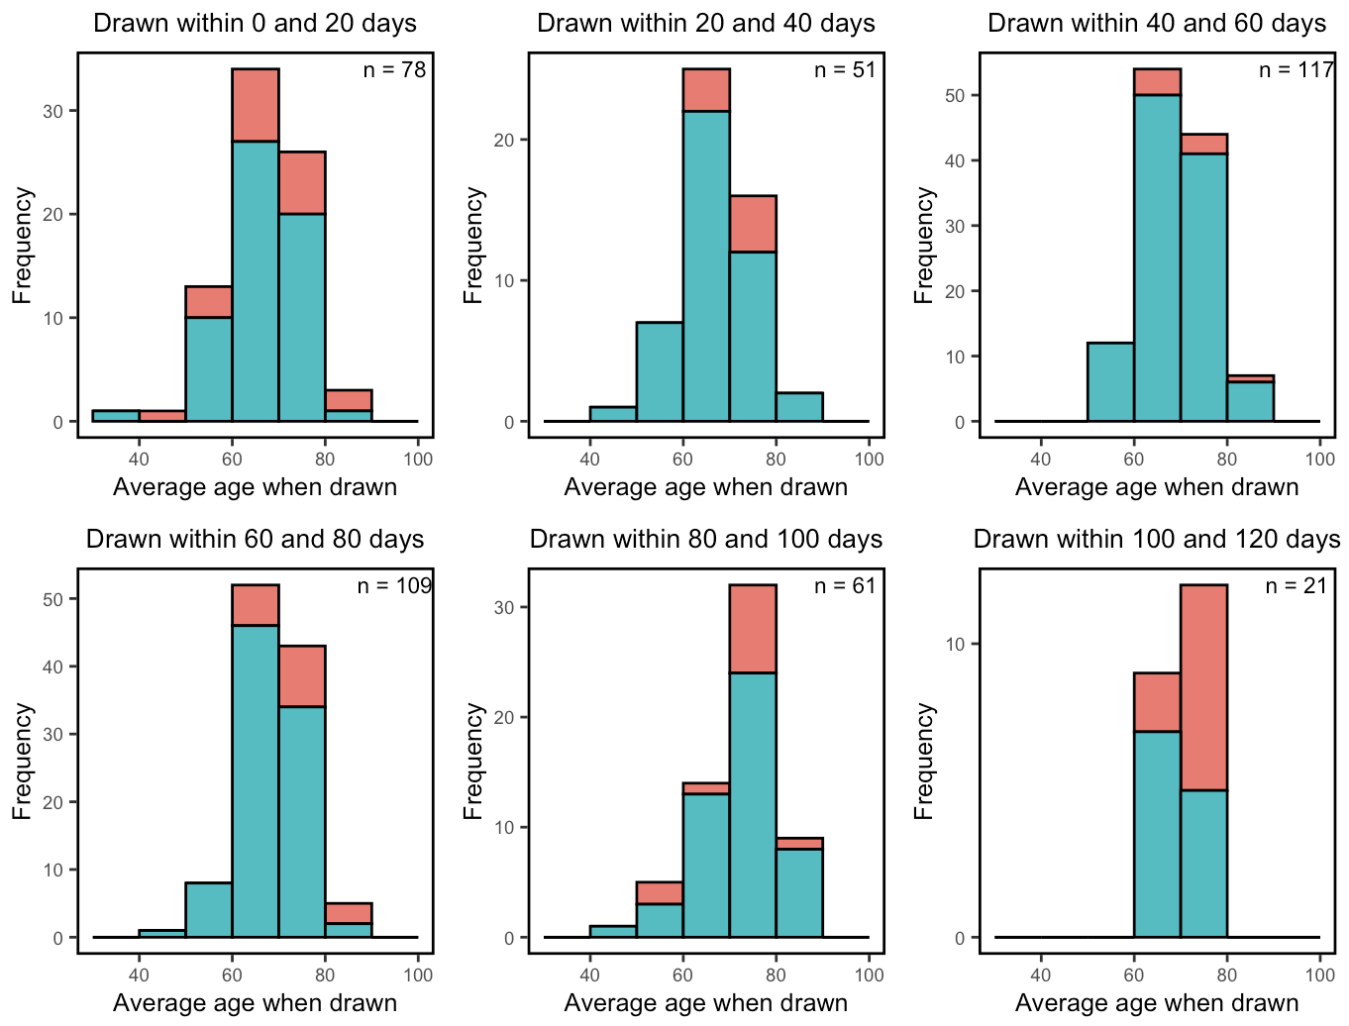
Population for Combined dataset (Stanford + Knight < 120 days),
without ambiguous patients in Knight Dataset

Slide 22
Time-Series Heatmap

Slide 23
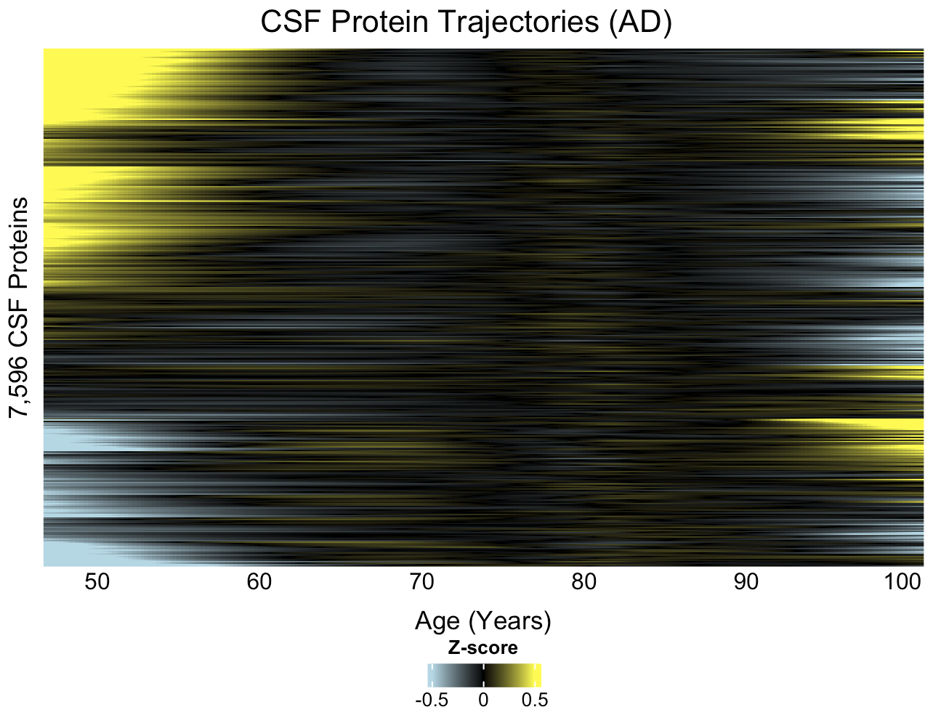
For AD patients’ CSF within Knight (<180 days) dataset.
Ordered by hierarchical clustering. Trajectories are LOESS interpolated.
* This is before summer, when we filtered out the ambiguous patients in the Knight dataset.

Slide 24
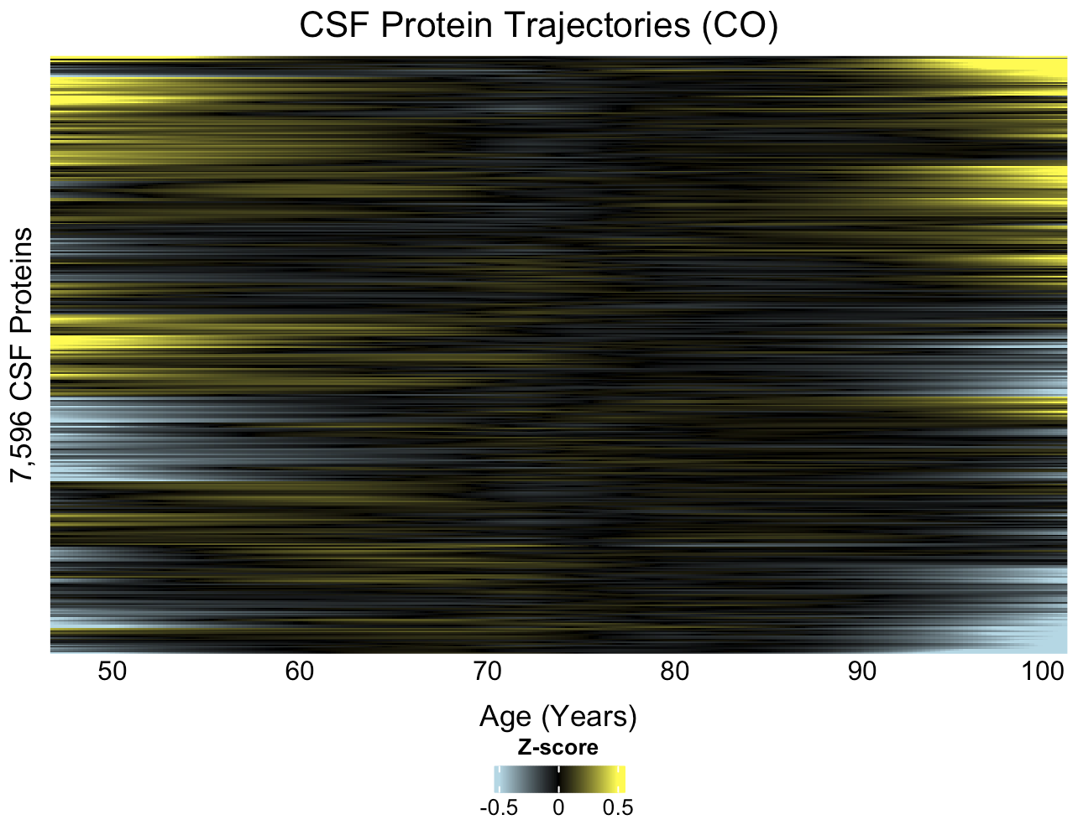
For CO patients’ CSF within Knight (<180 days) dataset.
Ordered by hierarchical clustering. Trajectories are LOESS interpolated.
* This is before summer, when we filtered out the ambiguous patients in the Knight dataset.

Slide 25
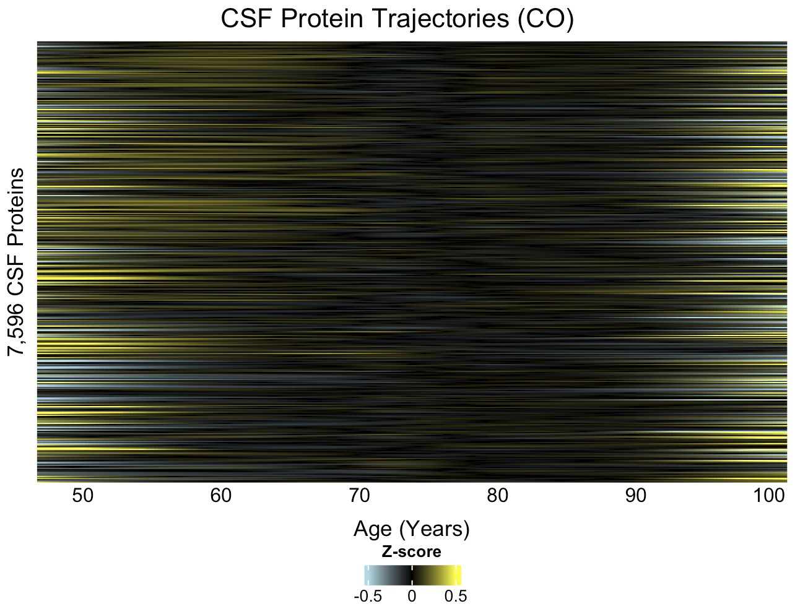
For CO patients’ CSF within Knight (<120 days) dataset.
Ordered by the same row indices as the AD heatmap. Trajectories are LOESS interpolated.
* This is before summer, when we filtered out the ambiguous patients in the Knight dataset.

Slide 26
Clustering Analysis

Slide 27
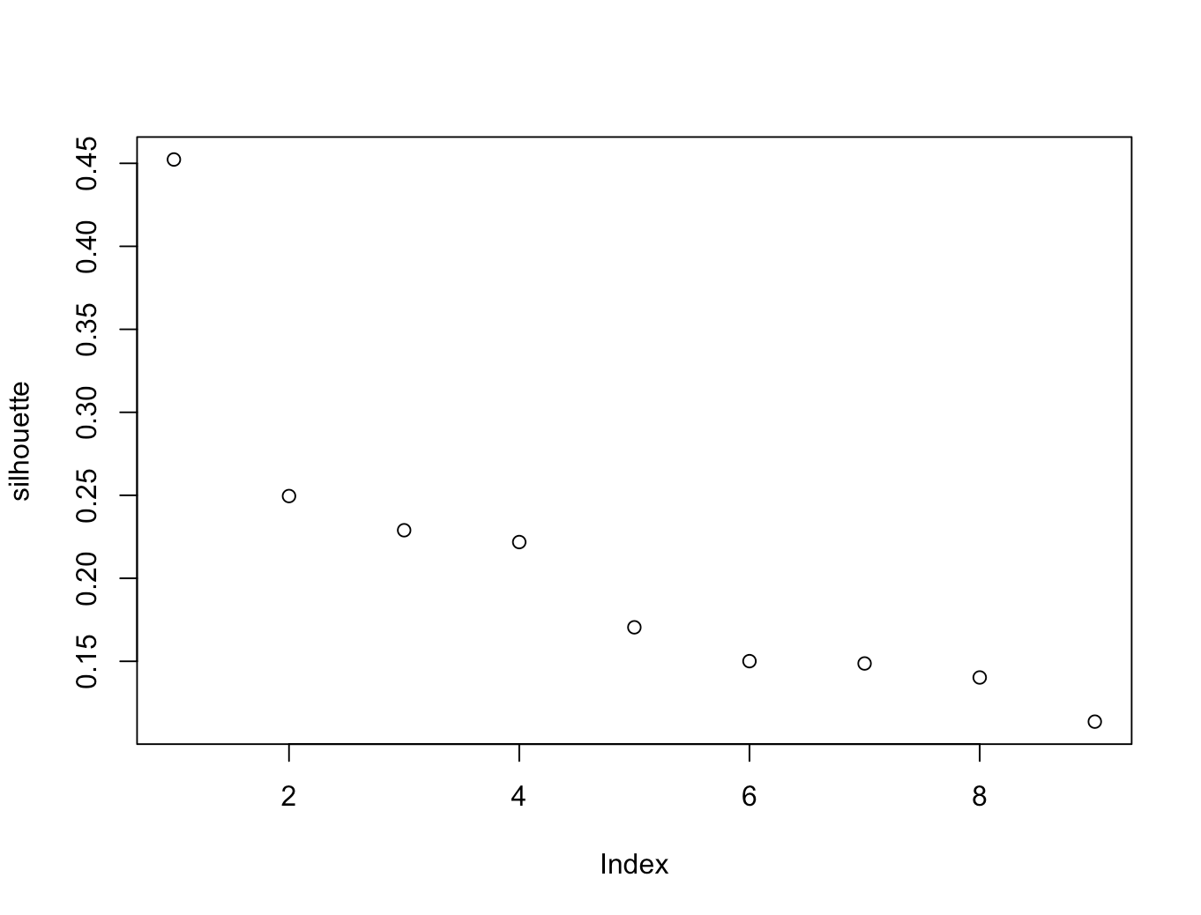
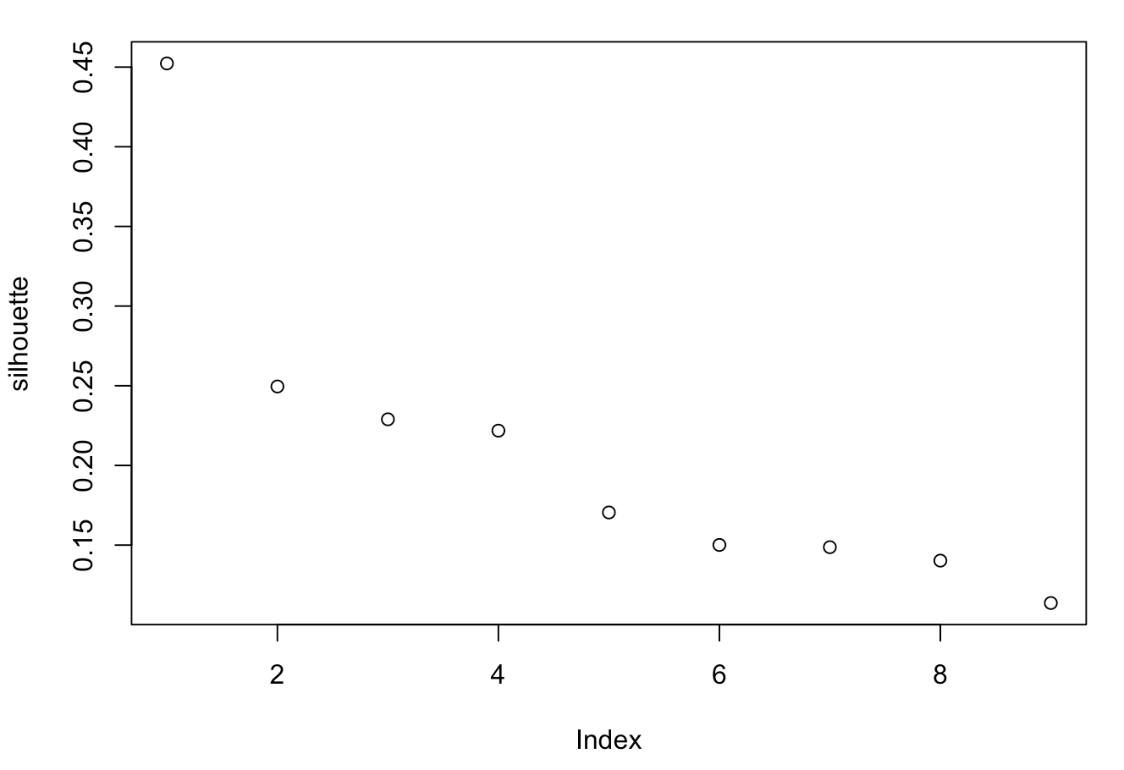
Silhouette Scores for Hierarchically Clustering (Complete Linkage) CSF – Plasma Ratio
AD (Left) CO (Right)
For Combined (Stanford + Knight <120 days) dataset.
* This is before summer, when we filtered out the ambiguous patients in the Knight dataset.

Slide 28
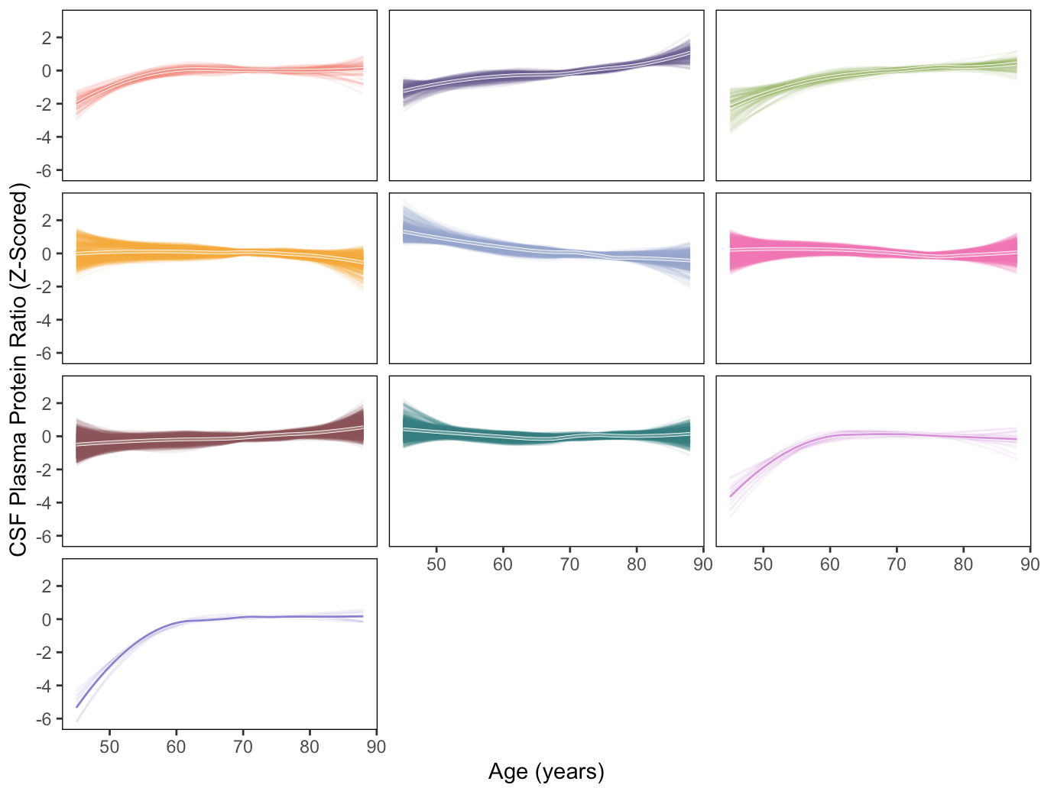
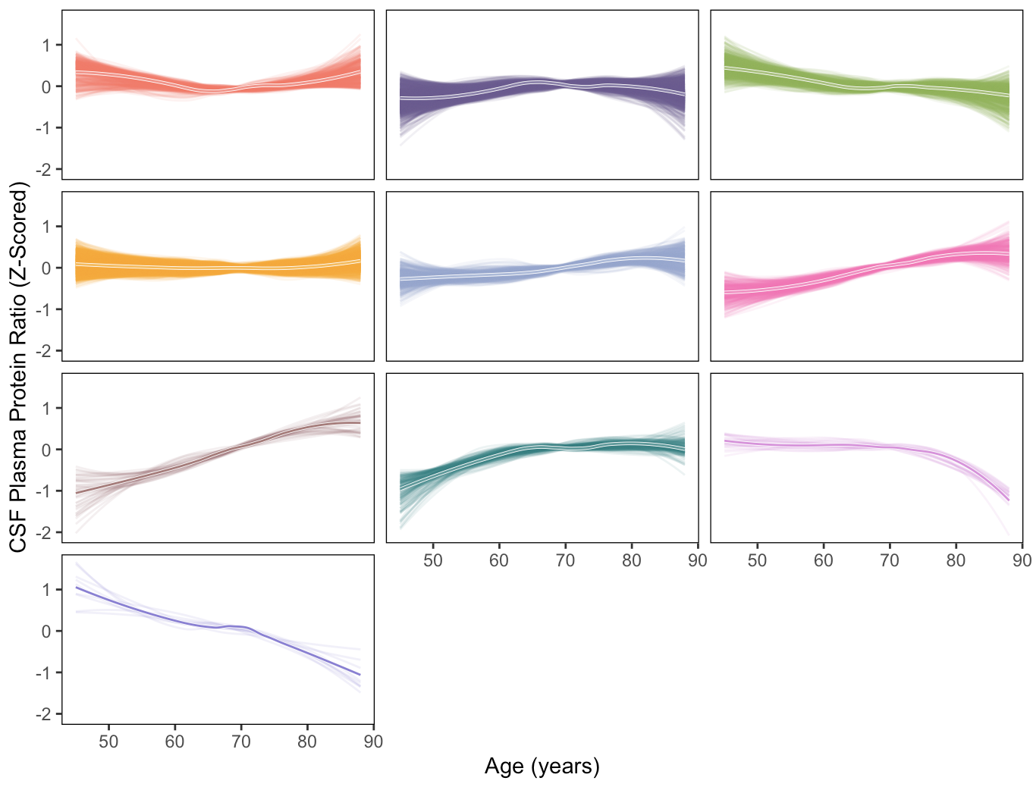
Hierarchically Clustering (Complete Linkage) and LOESS-interpolating CSF – Plasma Ratio
AD (Left) CO (Right)
For Combined (Stanford + Knight <120 days) dataset.
* This is before summer, when we filtered out the ambiguous patients in the Knight dataset.

Slide 29
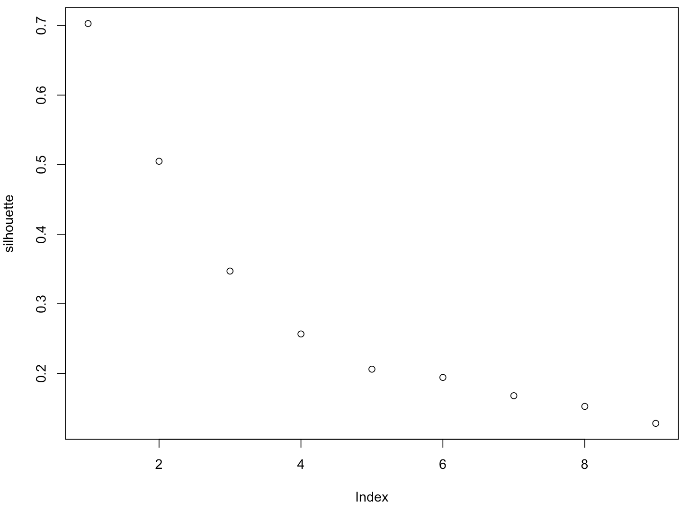
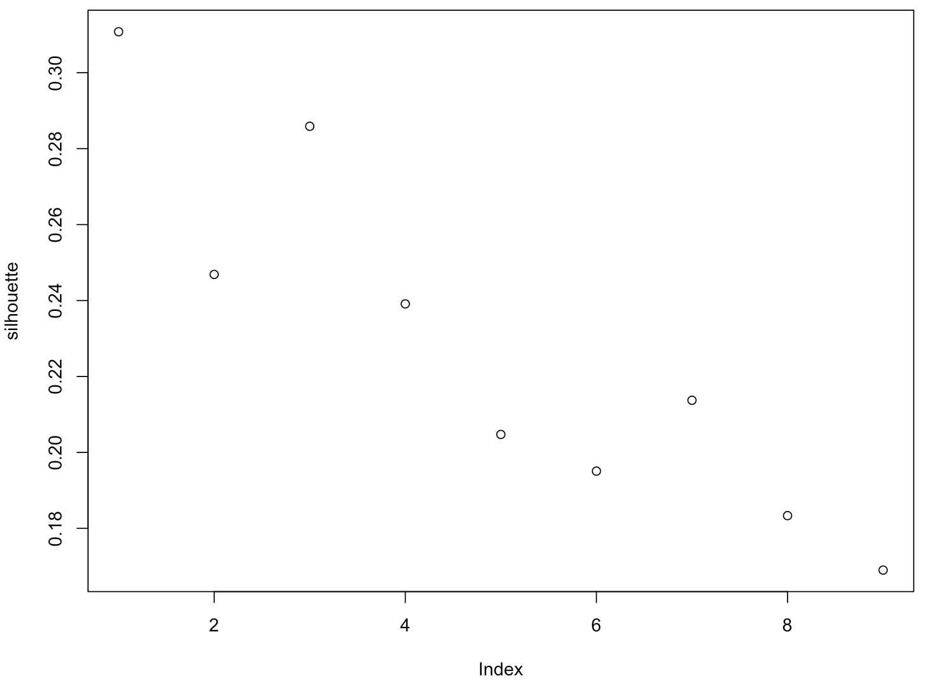
Silhouette Scores for Hierarchically Clustering (Complete Linkage) CSF
AD (Left) CO (Right)
For Combined (Stanford + Knight <120 days) dataset.
* This is before summer, when we filtered out the ambiguous patients in the Knight dataset.

Slide 30
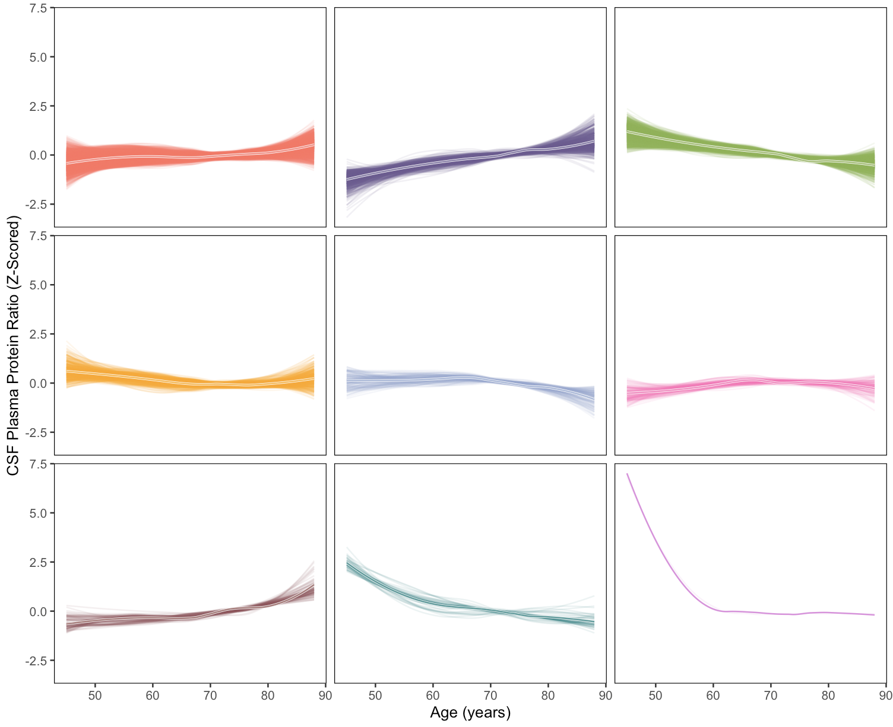
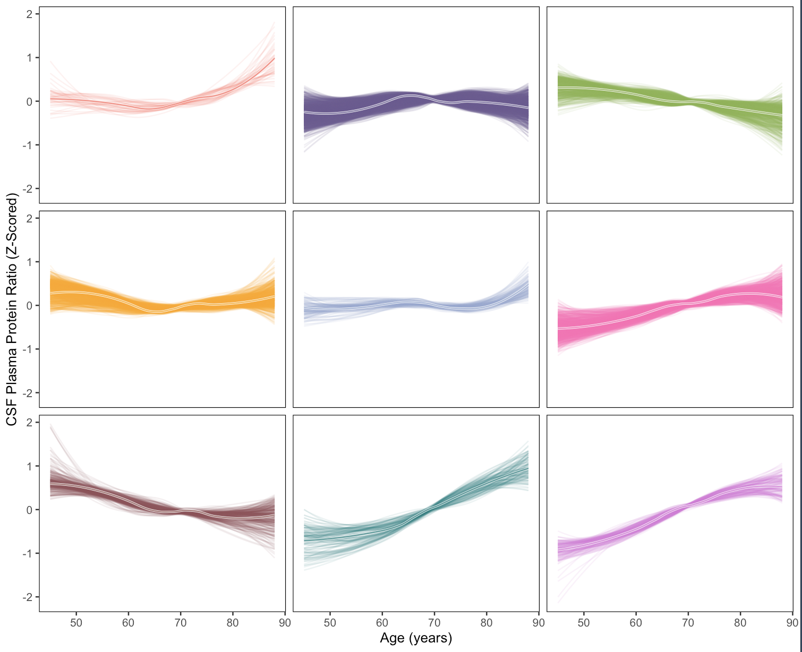
Hierarchically Clustering (Complete Linkage) and LOESS-interpolating CSF
AD (Left) CO (Right)
For Combined (Stanford + Knight <120 days) dataset.
* This is before summer, when we filtered out the ambiguous patients in the Knight dataset.

Slide 31
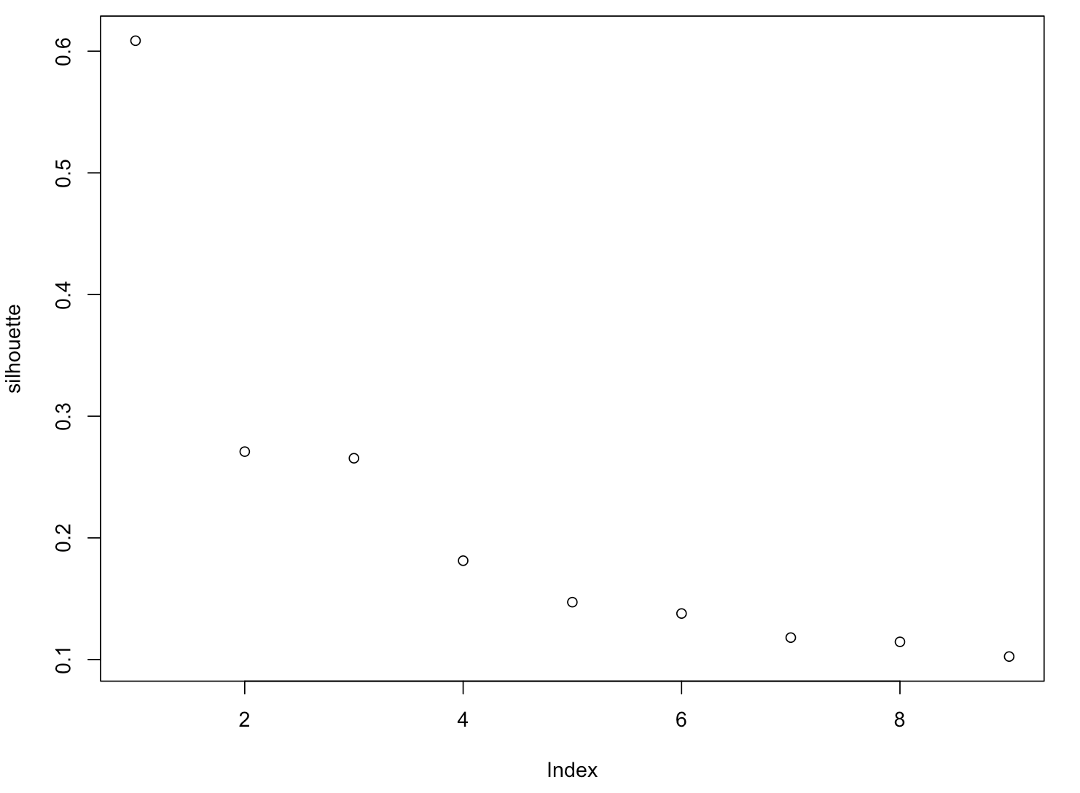
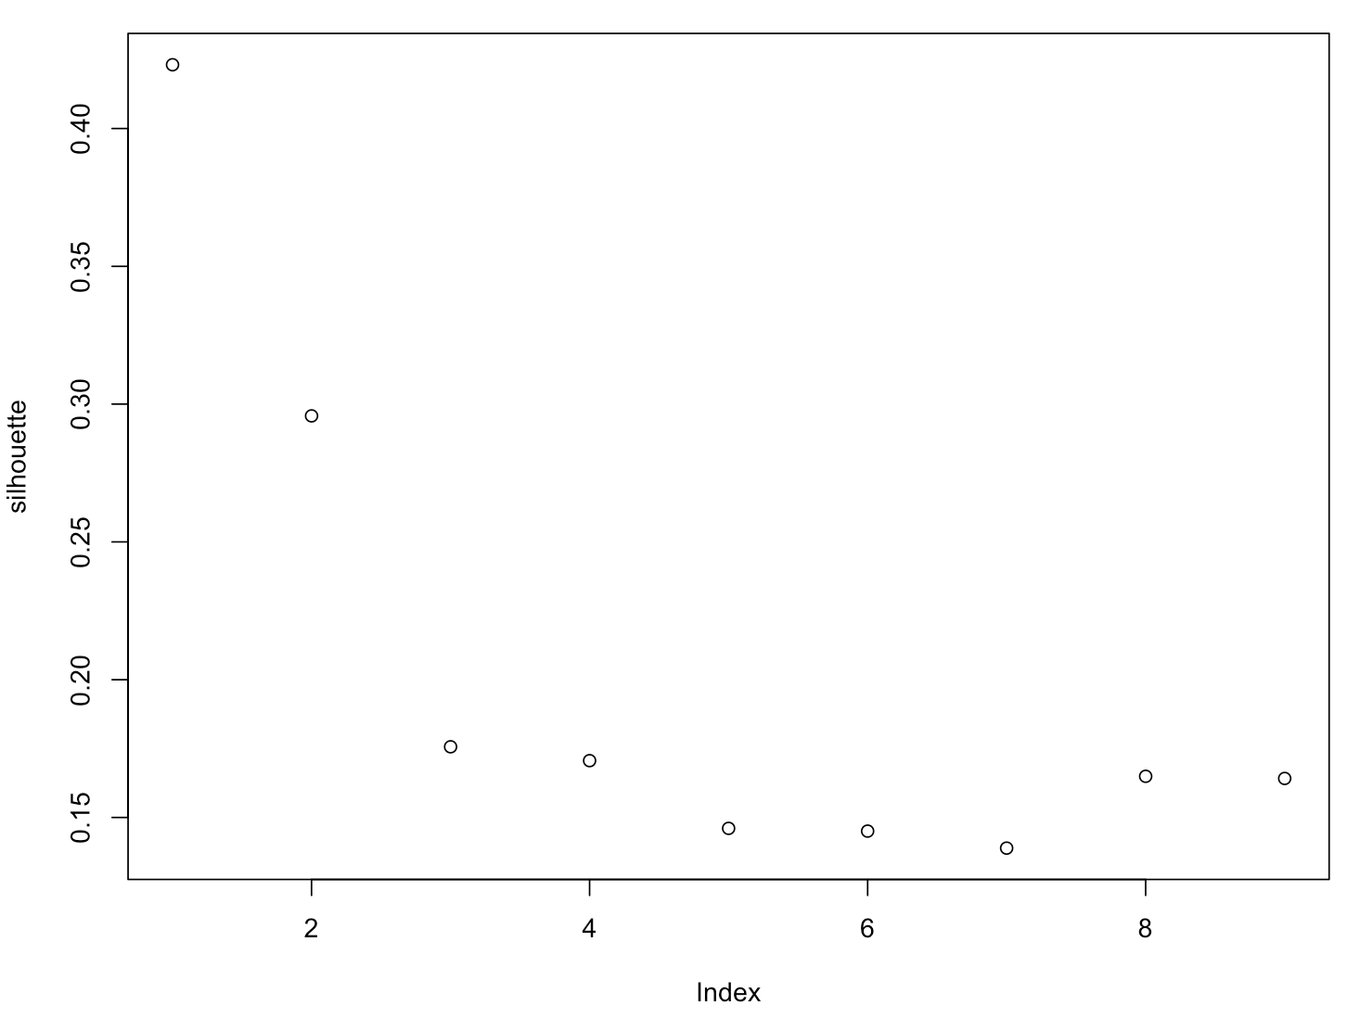
Silhouette Scores for Hierarchically Clustering (Complete Linkage) Plasma
AD (Left) CO (Right)
For Combined (Stanford + Knight <120 days) dataset.
* This is before summer, when we filtered out the ambiguous patients in the Knight dataset.

Slide 32
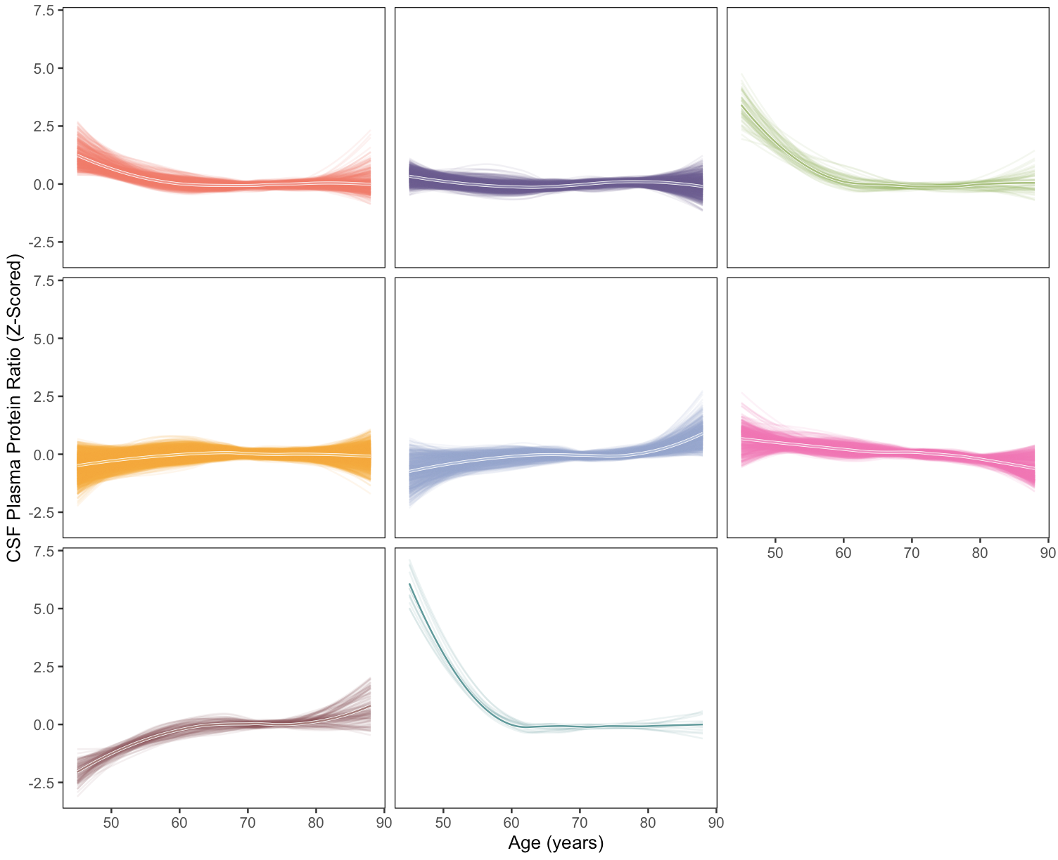
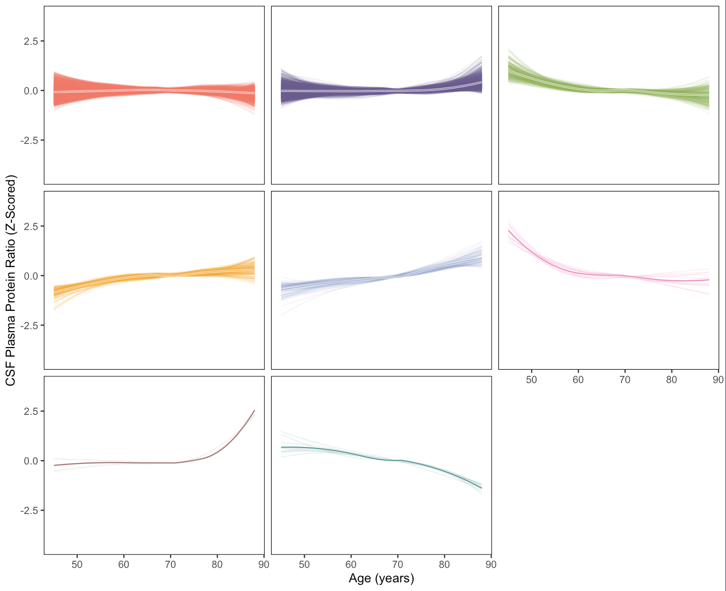
Hierarchically Clustering (Complete Linkage) and LOESS-interpolating Plasma
AD (Left) CO (Right)
For Combined (Stanford + Knight <120 days) dataset.
* This is before summer, when we filtered out the ambiguous patients in the Knight dataset.

Slide 33
Network Analysis using WGCNA

Slide 34
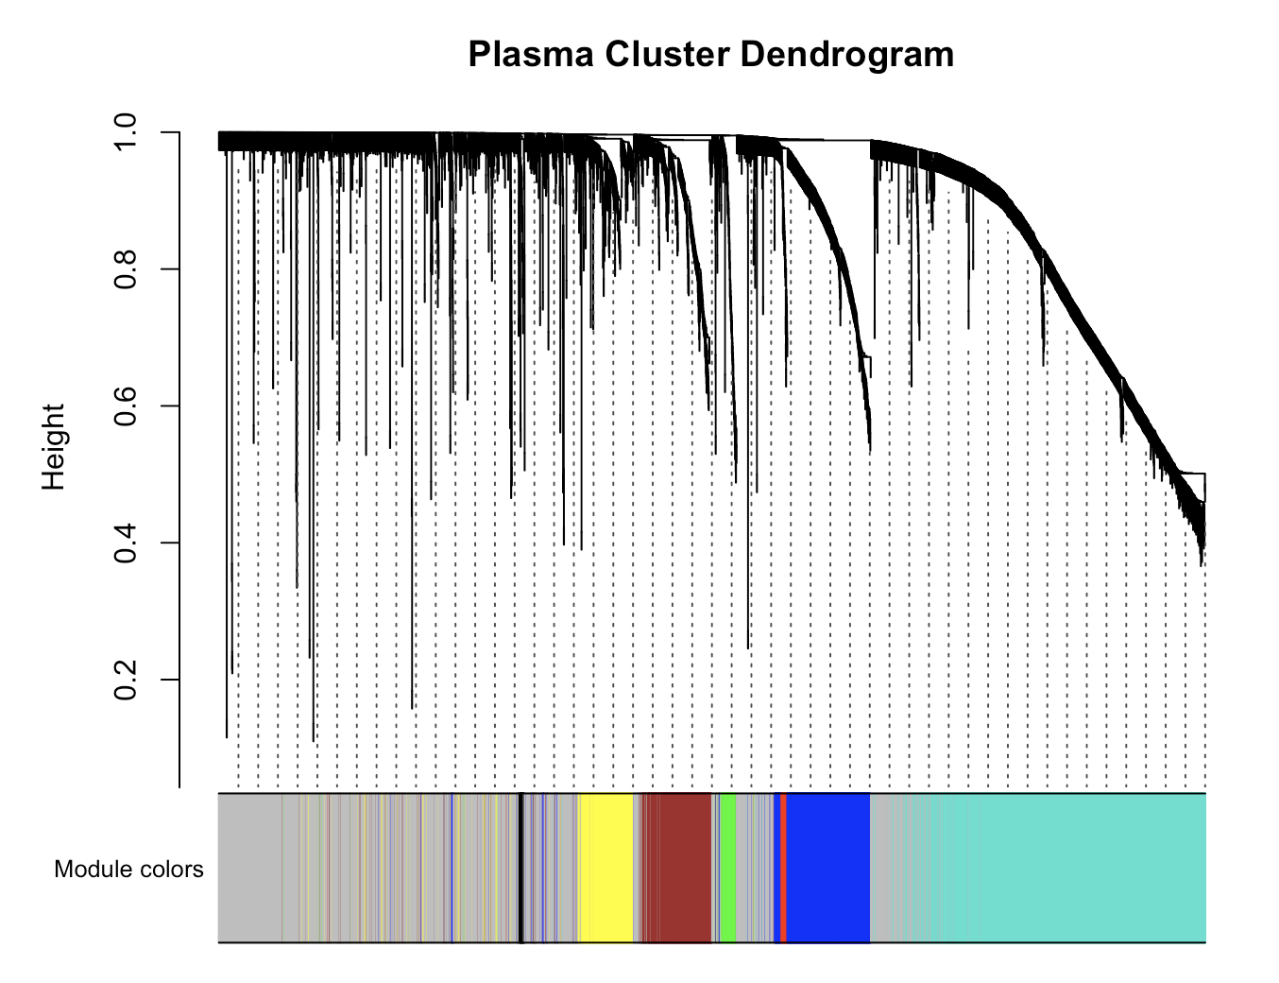
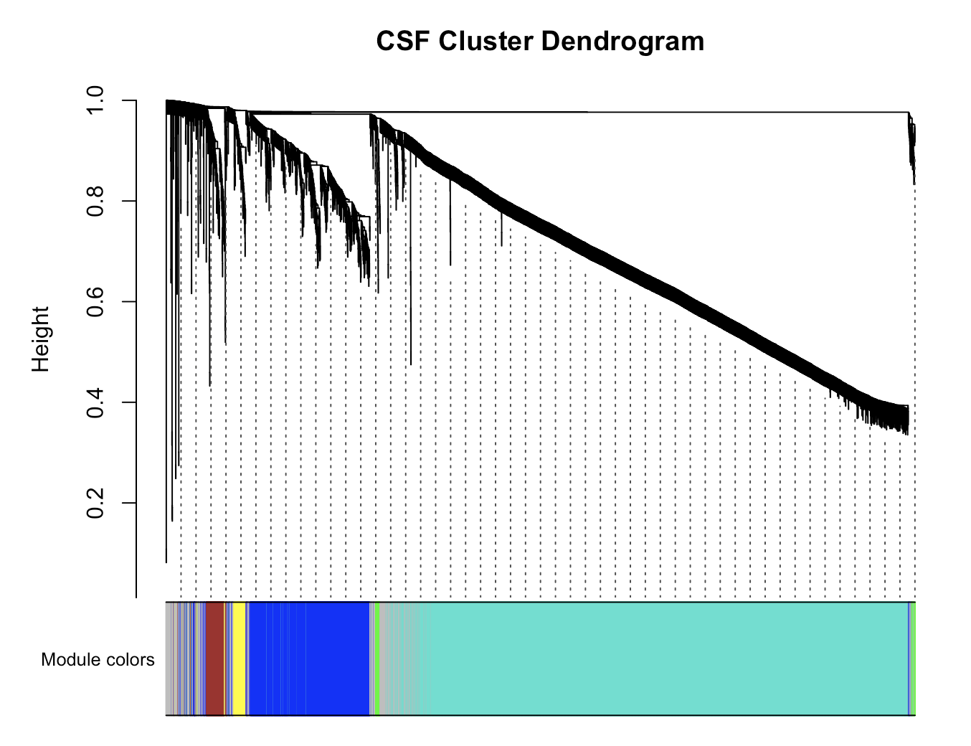
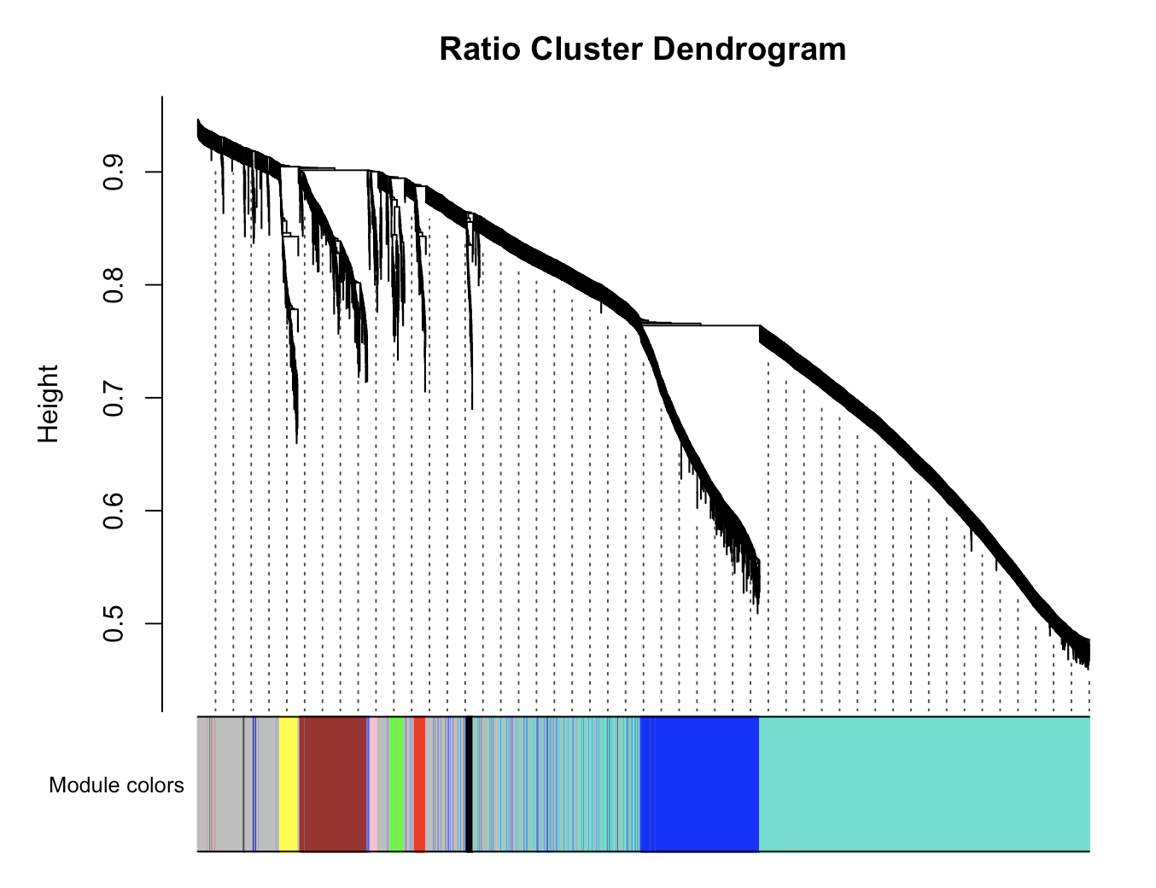
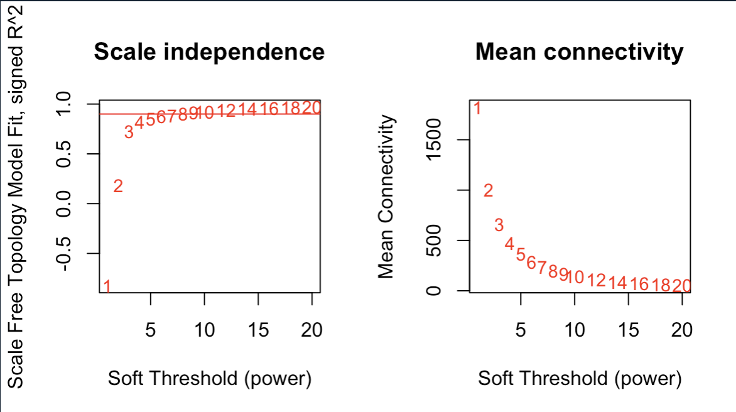

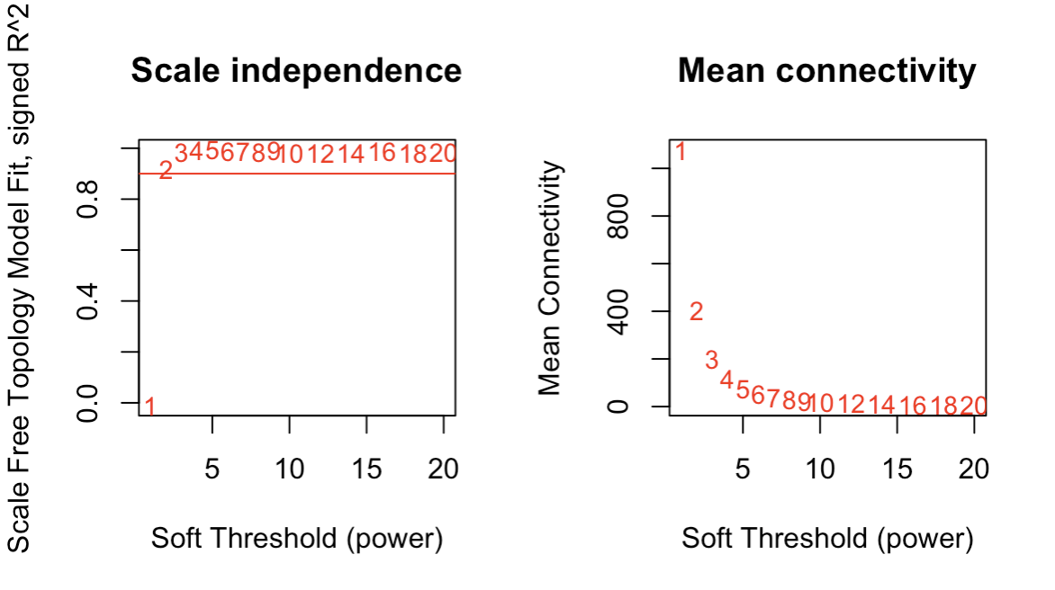
Soft thresholding (Power function)
Beta = 6
Beta = 6
Beta = 2

Slide 35
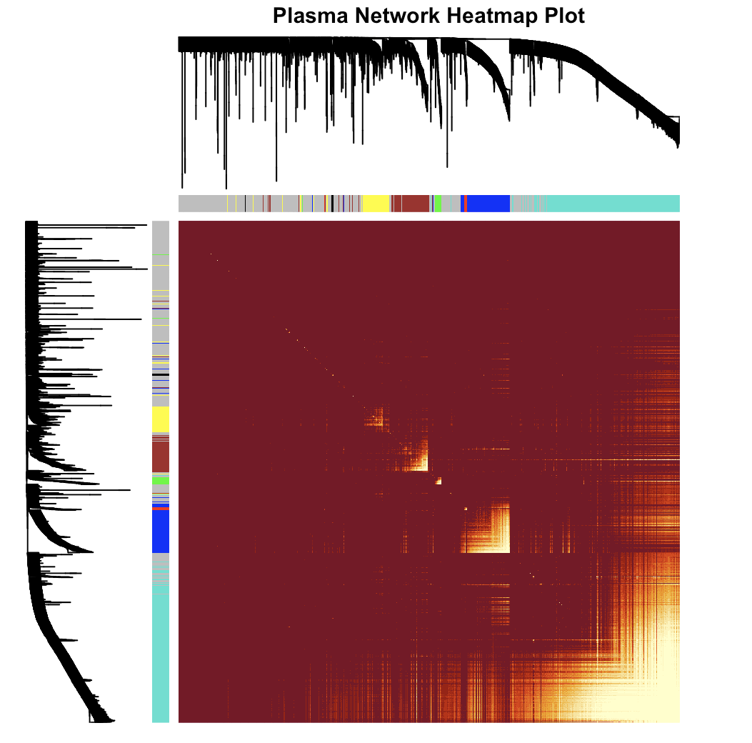
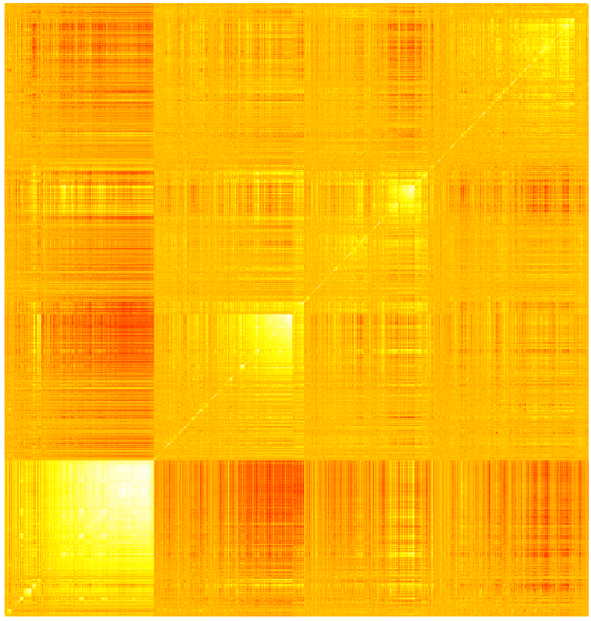
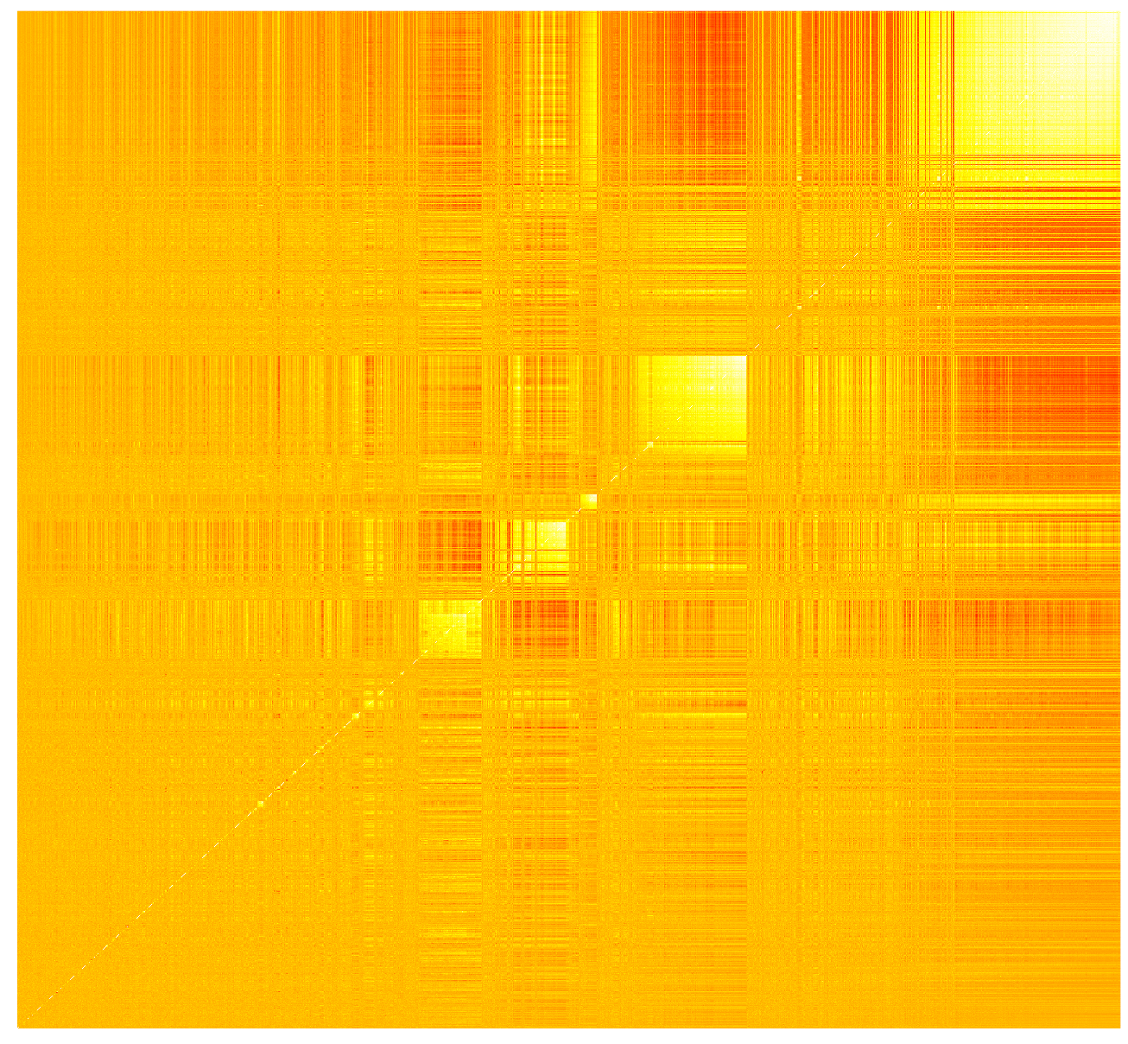
Hierarchically
Clustered
(Raw)
WGCNA
clustered

Slide 36
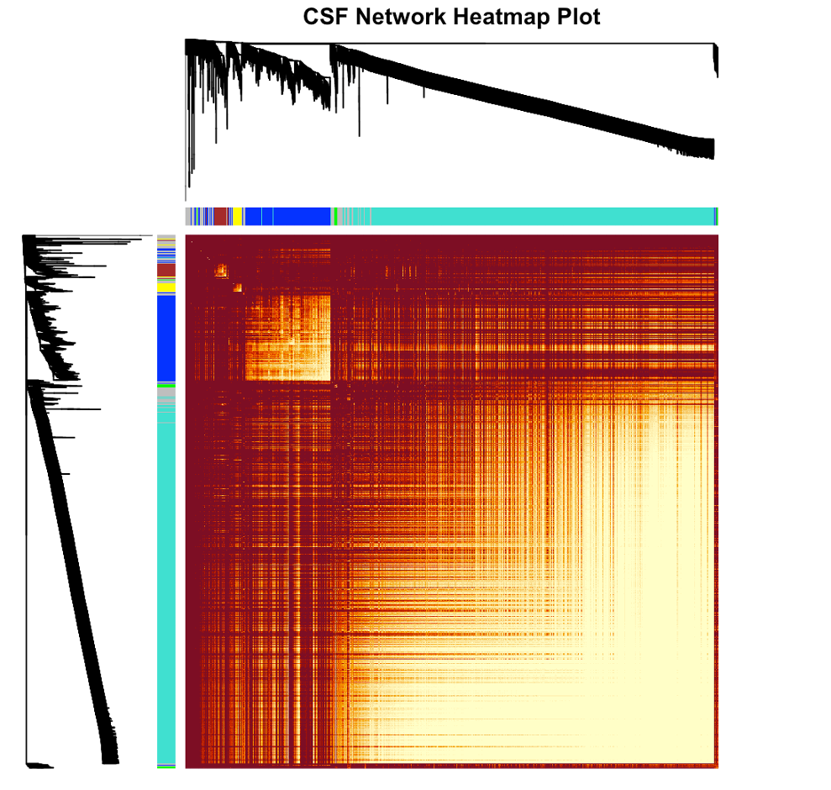
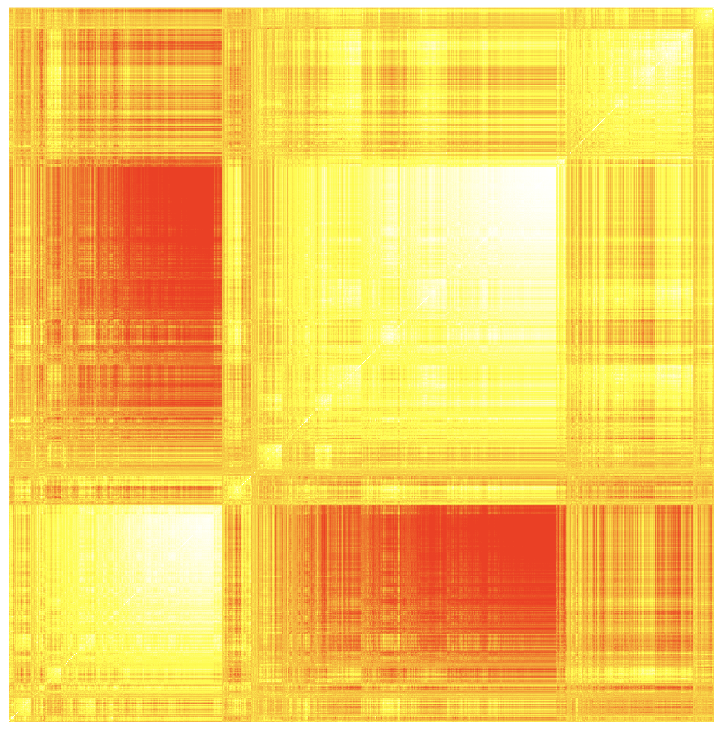
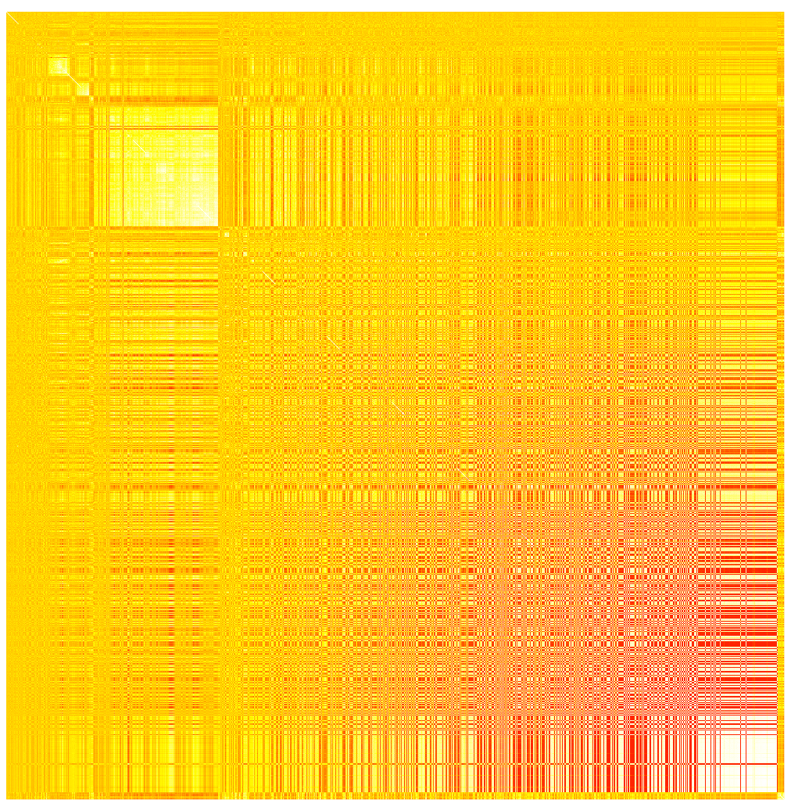
Hierarchically
Clustered
(Raw)
WGCNA
clustered

Slide 37



Hierarchically
Clustered
(Raw)
WGCNA
clustered

Slide 38
Differential Expression Analysis

Slide 39


- Stats summary for important proteins
- Litareture search?
- Any known relationships between CSF & Plasma Proteins
- On the ranks rather than raw values (Essentially INT)
* Some proteins have unexpected log2fc values bc this is ratio
For Combined (Stanford + Knight <120 days) dataset. CSF – Plasma Ratio
Variables: Sex, Age, Drawdate diff, Storage days, Batch effect
AD (Left), CO (Right)

Slide 40

* Some proteins have unexpected log2fc values bc this is ratio
For Combined (Stanford + Knight <120 days) dataset. CSF – Plasma Ratio
Variables: Sex, Age, Drawdate diff, Storage days, Batch effect

Slide 41

For Combined (Stanford + Knight <120 days) dataset, CSF, Stratified Analysis.
Variables: Sex, Age, AD/CO, Drawdate diff, Storage days, Batch effect

Slide 42

For Combined (Stanford + Knight <120 days) dataset, Plasma, Stratified Analysis.
Variables: Sex, Age, AD/CO, Drawdate diff, Storage days, Batch effect

Slide 43

* Some proteins have unexpected log2fc values bc this is ratio
For Combined (Stanford + Knight <120 days) dataset. CSF – Plasma Ratio. Stratified Analysis.
Variables: Sex, Age, AD/CO, Drawdate diff, Storage days, Batch effect

Slide 44


* Some proteins have unexpected log2fc values bc this is ratio
For Knight (<120 days) dataset, CSF – Plasma ratio.
Variables: Sex, Age
AD (Left), CO (Right)

Slide 45

For Knight (<120 days) dataset, CSF – Plasma Ratio, Interaction model.
Variables: Sex, Age * CDR, Drawdate diff, Storage days

Slide 46
Trajectory Similarity Analysis

Slide 47

Stanford Dataset, Z-scored CSF – Plasma Ratio
X: Euclidean similarity b/w CO and AD trajectory, Y: Normalized Cosine similarity (1– 0 Normalized expression levels)

Slide 48

Stanford Dataset, Z-scored CSF – Plasma Ratio
X: Euclidean similarity b/w CO and AD trajectory, Y: Cosine similarity

Slide 49
Ratio Stability Analysis
* All analyses in this category is done on CSF – Plasma Ratio data

Slide 50

Combined Dataset (Stanford, Knight <= 120 days), Sex Proteome by drawdate difference

Slide 51

Combined Dataset (Stanford, Knight <= 120 days), Aging Proteome by drawdate difference

Slide 52

Combined Dataset (Stanford, Knight <= 120 days), AD Proteome by drawdate difference

Slide 53

Combined Dataset (Stanford, Knight <= 120 days), Sex Proteome by drawdate difference

Slide 54

Combined Dataset (Stanford, Knight <= 120 days), Aging Proteome by drawdate difference

Slide 55

Combined Dataset (Stanford, Knight <= 120 days), AD Proteome by drawdate difference

Slide 56

Combined Dataset (Stanford, Knight <= 120 days), Inverse Normal Transformation Applied
Sex Proteome (Male) by drawdate difference

Slide 57

Combined Dataset (Stanford, Knight <= 120 days), Inverse Normal Transformation Applied
Aging Proteome by drawdate difference

Slide 58

Combined Dataset (Stanford, Knight <= 120 days), Inverse Normal Transformation Applied
AD Proteome by drawdate difference

Slide 59

Combined Dataset (Stanford, Knight <= 120 days),
Sex Proteome log2fc values of drawdate bins against each other

Slide 60

Combined Dataset (Stanford, Knight <= 120 days),
AD Proteome log2fc values of drawdate bins against each other

